Slide 1



Slide 2













BUSINESS OVERVIEW
Establishment
INDIAEXCITE - 2022
Company
Indiaexcite IT Solutions Pvt Ltd
Brand
INDIAEXCITE
Focus
LMS - Transforming University Education
Seamless Integration with Any System
Universal API Connector
AI Based – Mentor Bots
Personalized guidance - 24/7 availability - instant responses
Zoom Integration for Virtual Classes
Seamless zoom integration for virtual classes
Advanced Assessment and Grading
Versatile assessments: quizzes/mcqs, assignments, peer reviews
Detailed Feedback
Provide detailed assignment feedback for student improvement
Mobile Learning
Mobile App for courses, push notifications, assignments, deadlines
Integration with Third-Party Tools
Library resources, external applications for enhanced learning
Robust Analytics and Reporting
Track student performance, engagement metrics, detailed analytics, custom reports.

Slide 3
Assignment-Based Customized
LMS for Enhanced Learning
Streamlined Assignment Handling with Hybrid Implementation

Slide 4
Overview of Assignment-Based Exams
Admin Role: Uploads faculty assignments and sets deadlines. Student Role: Downloads assignments, completes them, and uploads answer sheets.
Faculty Role: Accesses, corrects, and uploads marked answer sheets.
Evaluator Role: Reviews corrections and approves or requests further revisions.

Slide 5
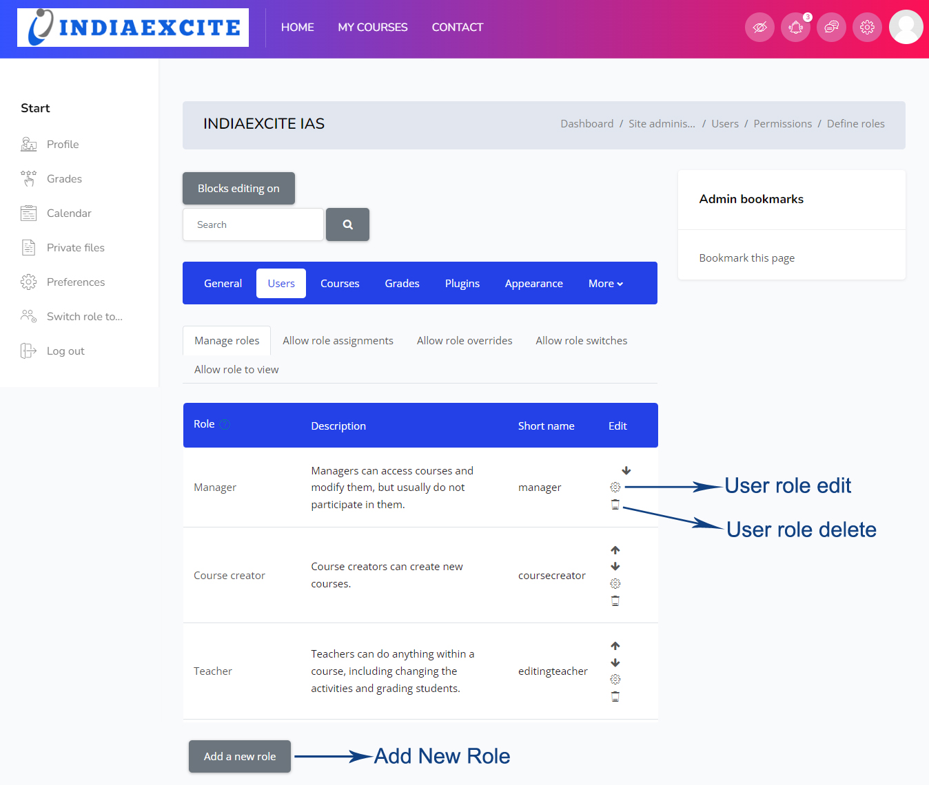
Overview of Assignment-Based Exams

Slide 6
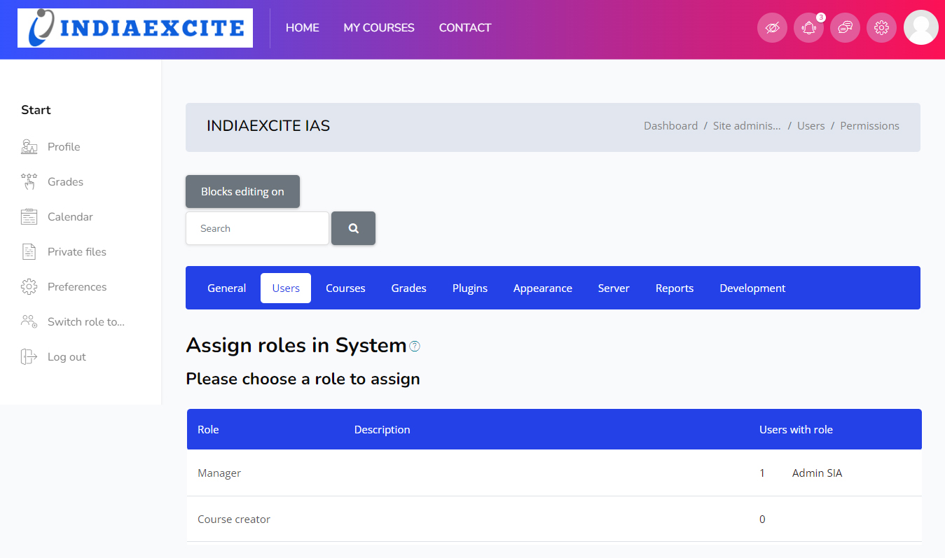
Overview of Assignment-Based Exams

Slide 7
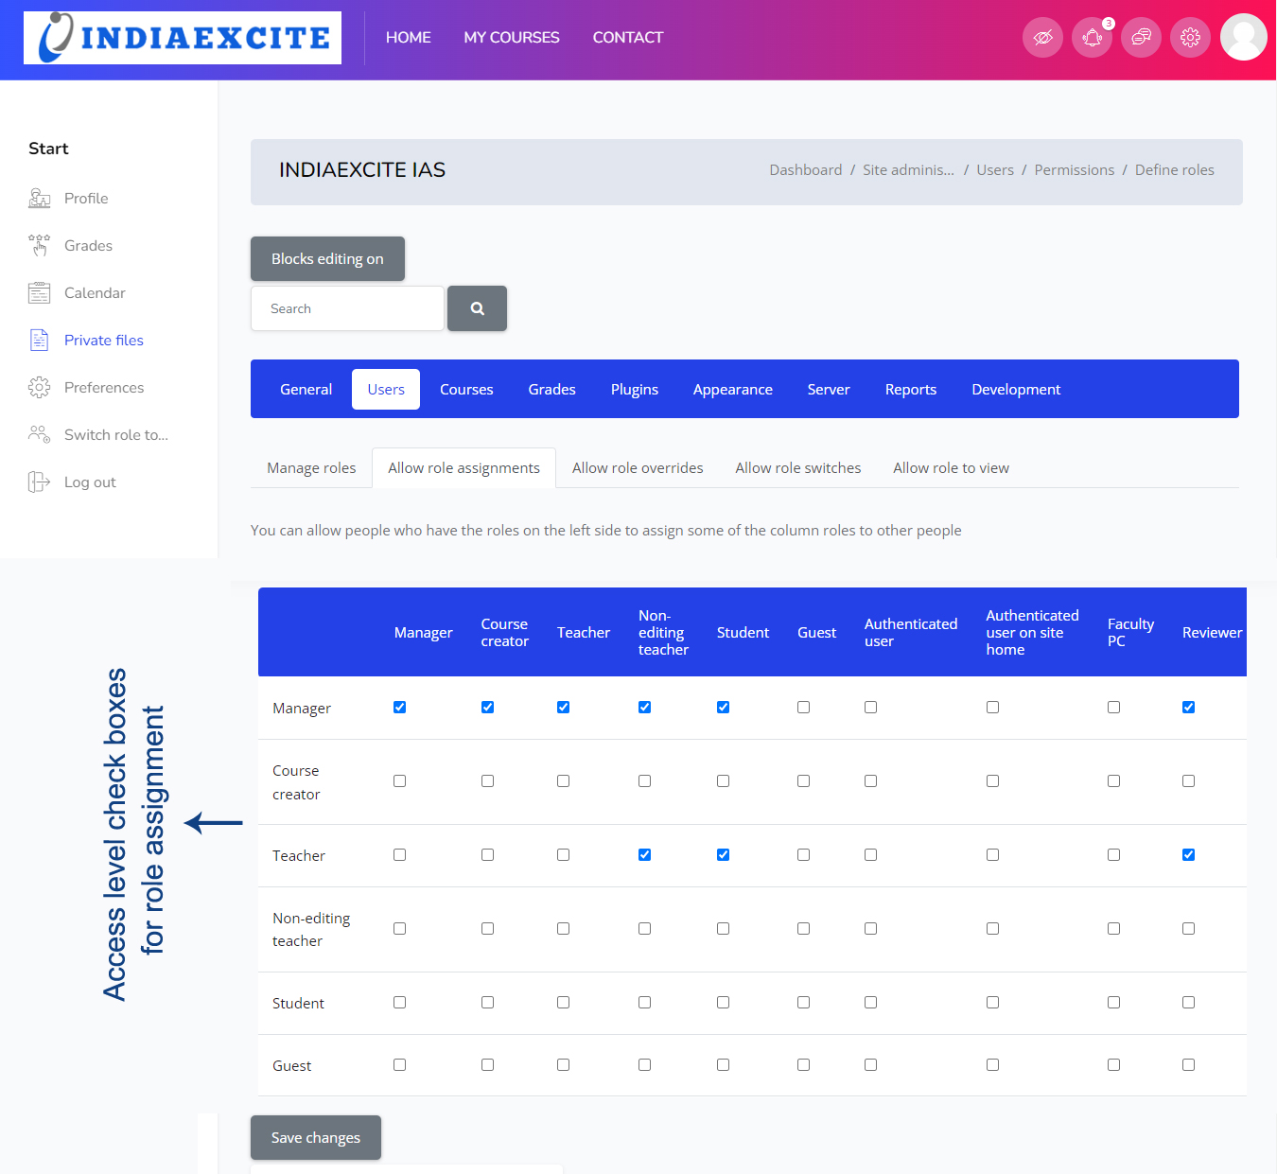

Slide 8
Hybrid Implementation
ONLINE STUDENTS:
Registered students will have the ability to log in through the platform, where they can access and download their assigned tasks and assignments.
Once students complete their work, they can upload their finished assignments for evaluation and further review.
ONLINE FACULTY:
Faculty members can log in to the system, where they will have access to the assignments assigned to their respective panels.
After reviewing and grading the students' work, faculty can upload the corrected papers for further assessment by the designated reviewer.

Slide 9
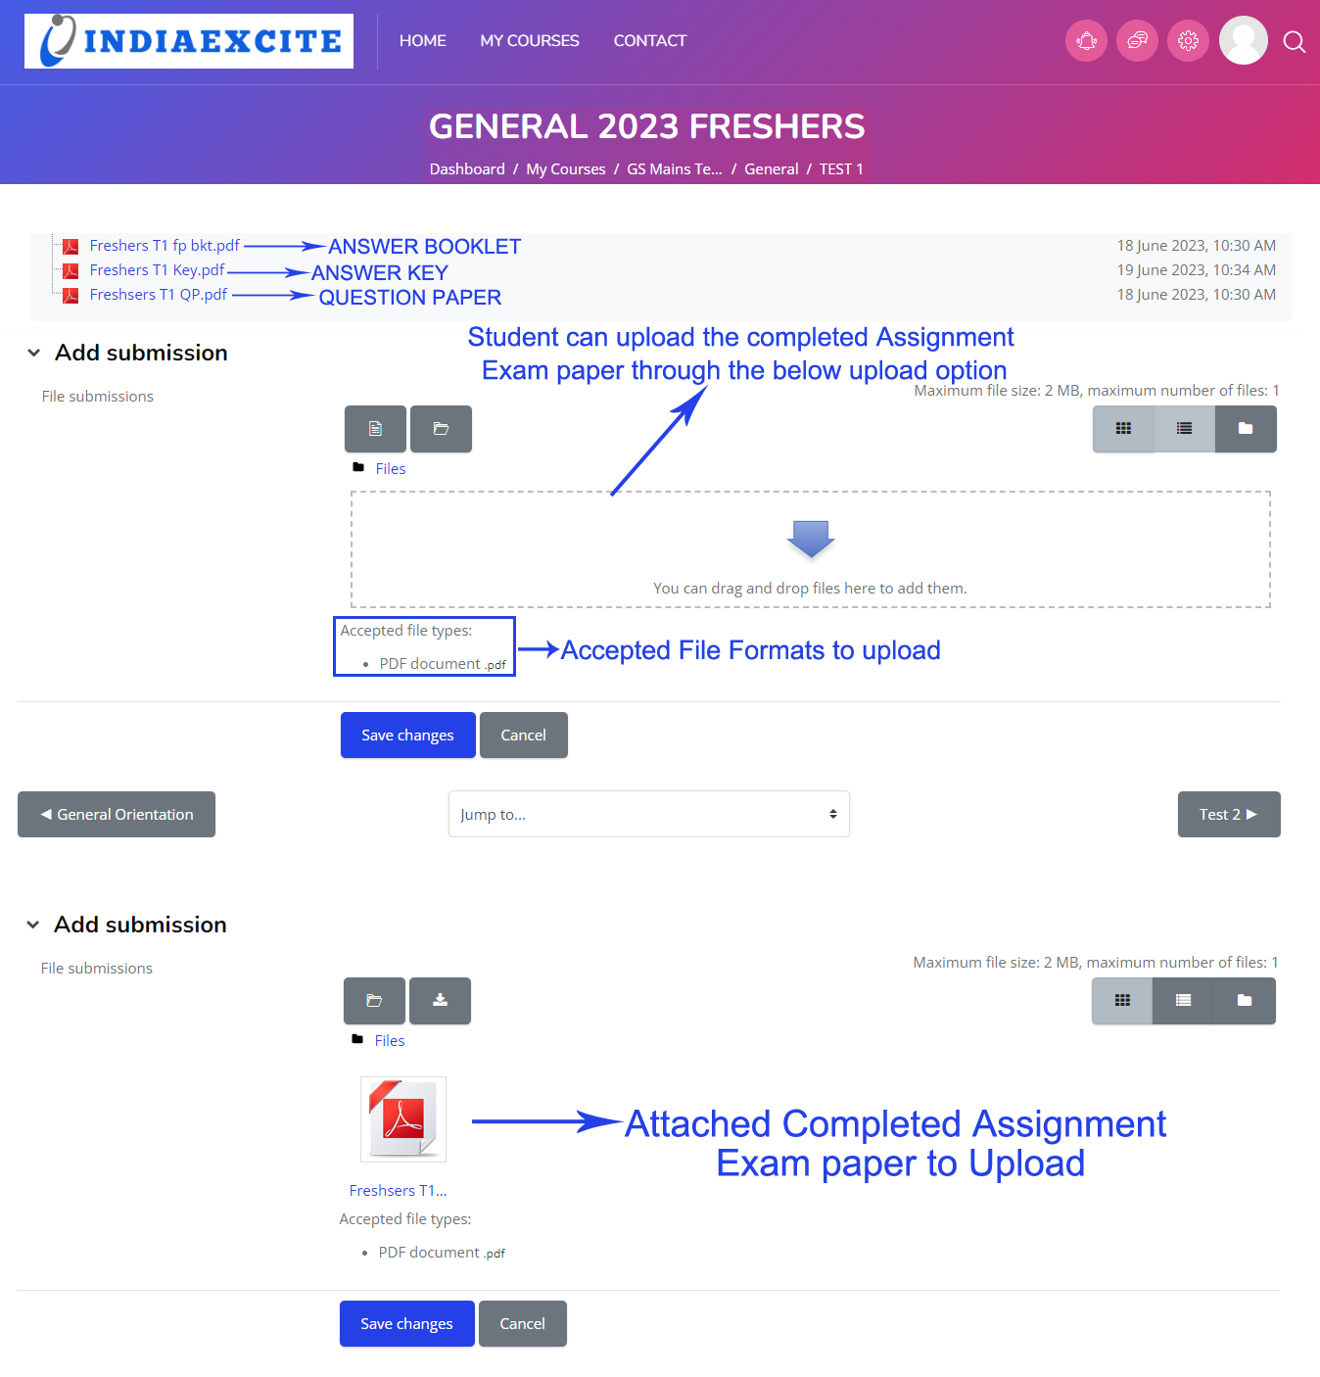
Hybrid Implementation – ONLINE STUDENTS

Slide 10
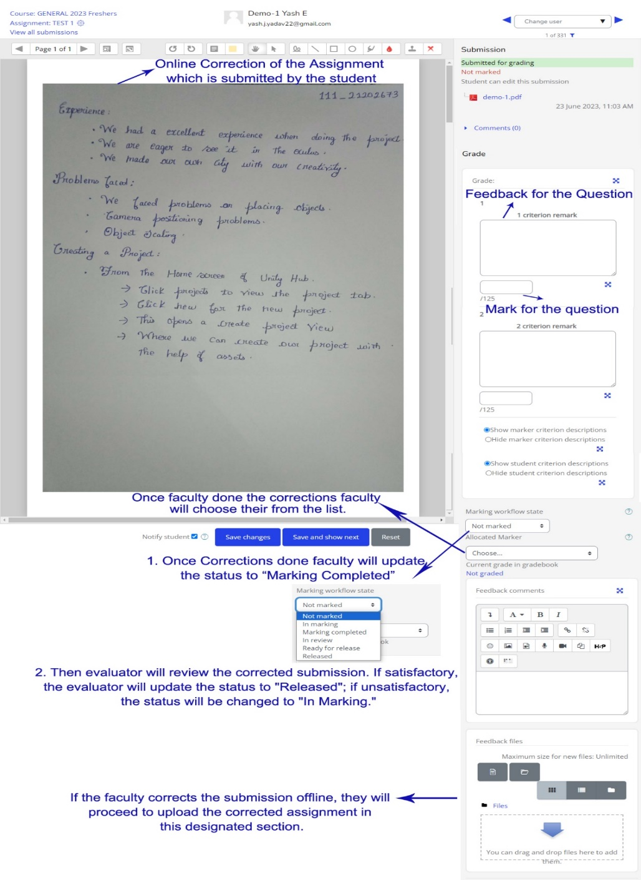
Hybrid Implementation – ONLINE FACULTY

Slide 11
Hybrid Implementation
Physical Submission:
Students write exams in classrooms.
Admins perform bulk uploads of scanned answer sheets.
Faculty Correction:
Manual correction in the classroom.
Bulk upload of corrected papers for digital processing.

Slide 12
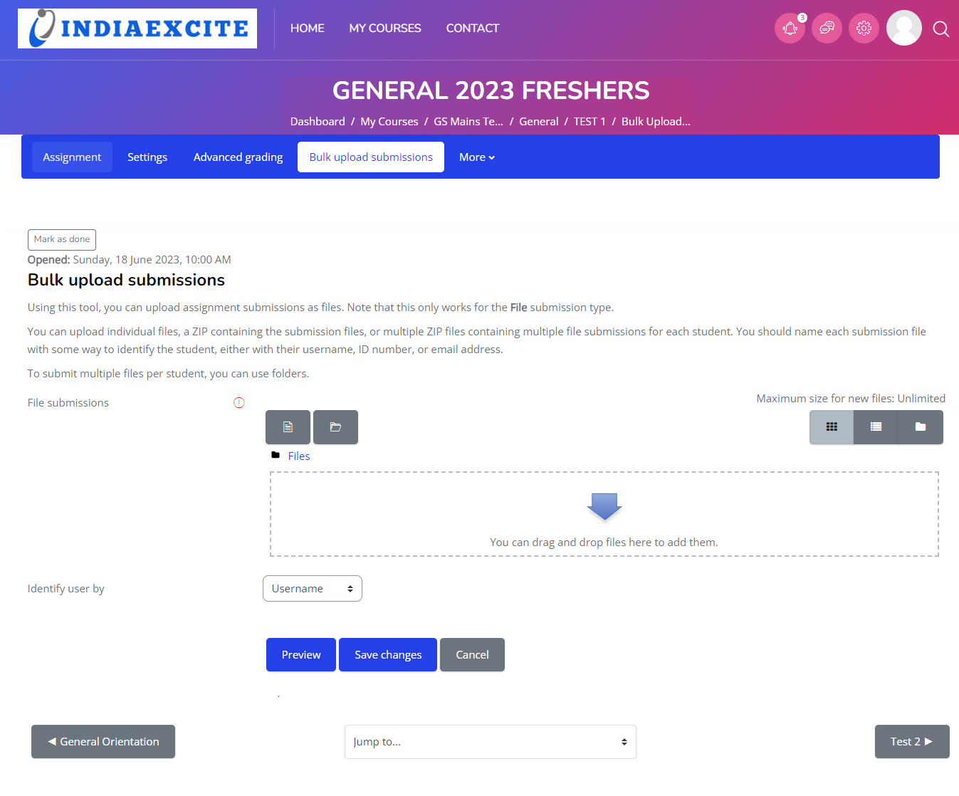
Hybrid Implementation – Physical Submission

Slide 13
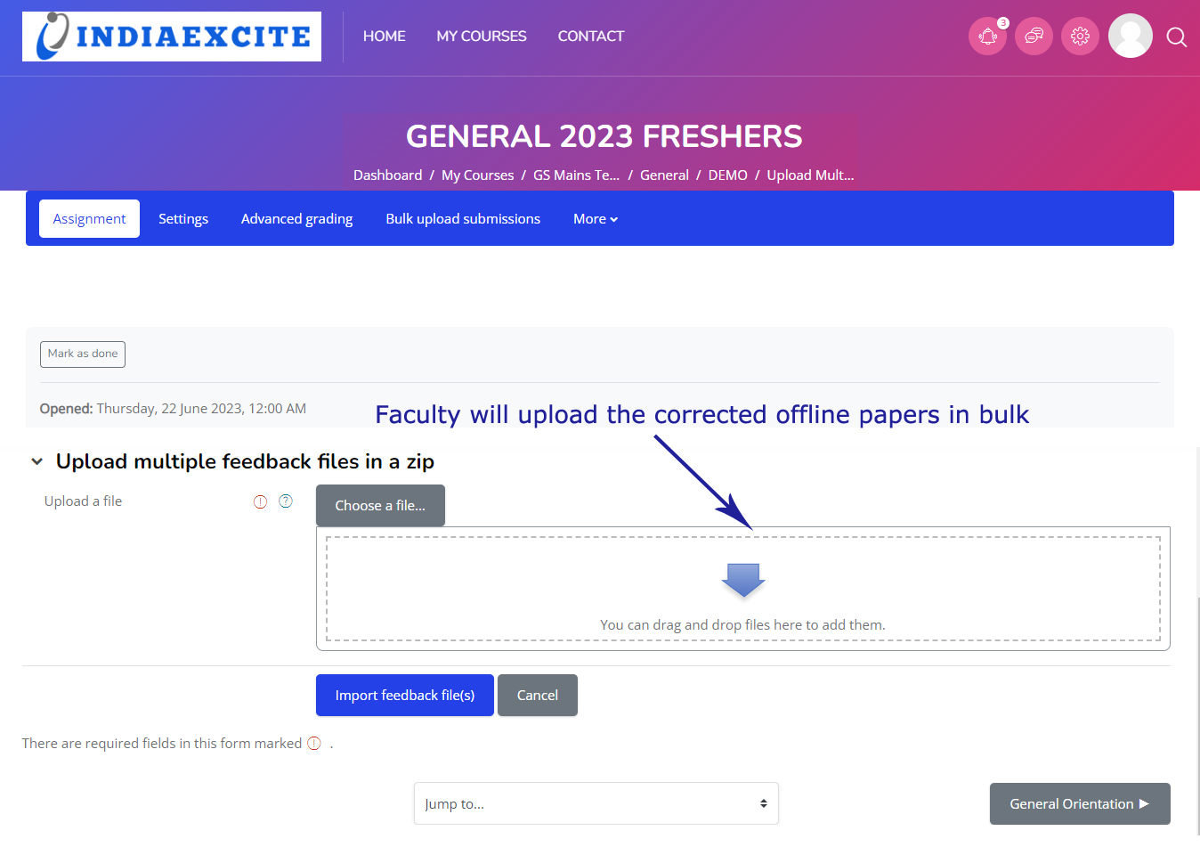
Hybrid Implementation – Faculty Correction

Slide 14
Assignment Module Features
Admin Capabilities:
Create assignments with PDFs (Answer Booklet, Question Paper, Answer Key).
Set submission formats and file limits.
Student Capabilities:
Access assignments from profiles and submit scanned answer sheets.

Slide 15
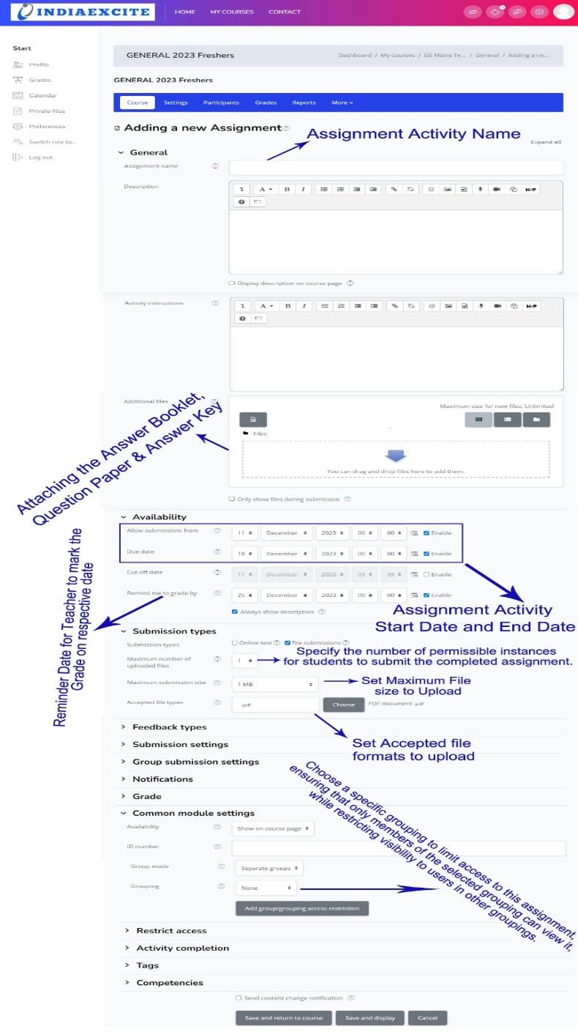
Assignment Module Features

Slide 16
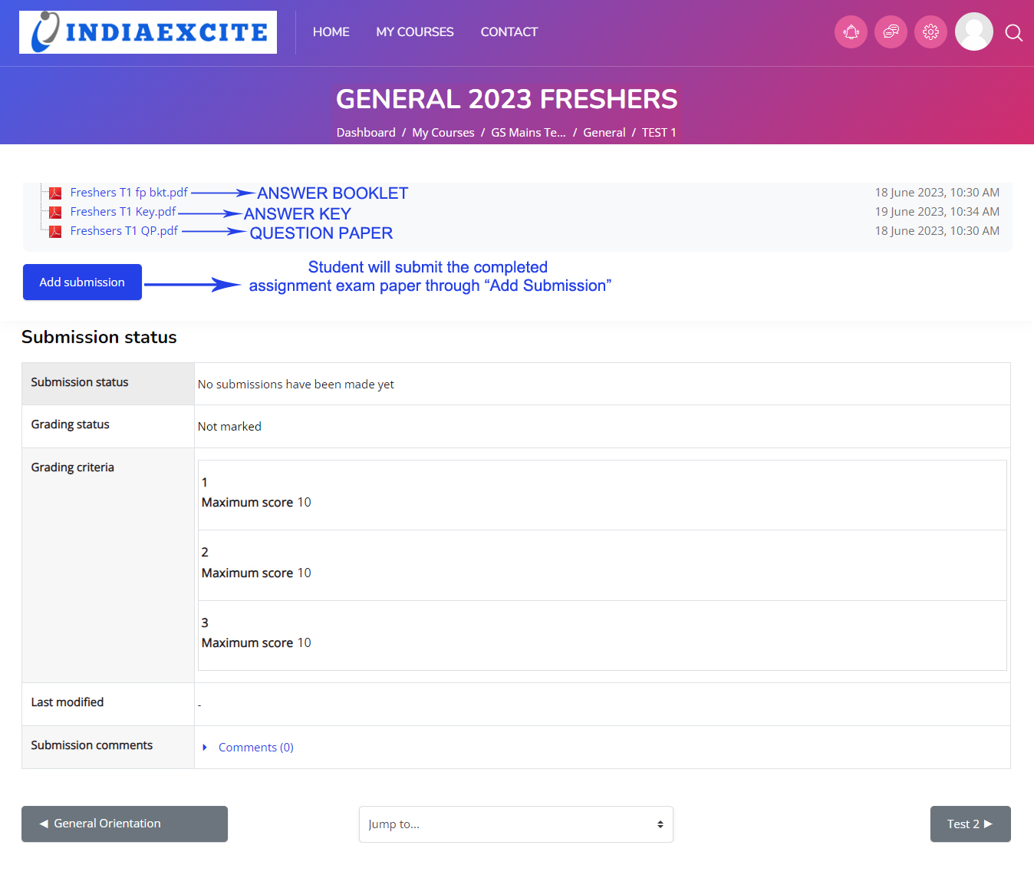
Assignment Module Features

Slide 17
Faculty Correction and Evaluation
Online Correction:
Faculty uses digital tools for grading and feedback..
Offline Correction:
Download, correct, and re-upload answer sheets.
Evaluation Workflow :
Evaluator assesses, releases, or reassigns for further corrections.

Slide 18

Faculty Correction and Evaluation - ONLINE

Slide 19
Faculty Correction and Evaluation - OFFLINE

Slide 20
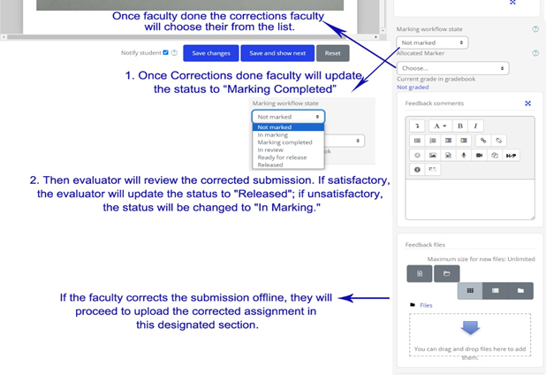
Faculty Correction and Evaluation – EVALUATION WORKFLOW

Slide 21
Bulk Upload and Feedback Management
Bulk Upload Module:
Efficiently handles multiple student submissions.
File names must match user identifiers for seamless processing.
Feedback Upload:
Supports batch feedback uploads with easy preview and grading options.

Slide 22
Bulk Upload and Feedback Management

Slide 23
Bulk Upload and Feedback Management

Slide 24
Student Module Highlights
Personalized Dashboard:
Profile editing, chat with teachers, and notification preferences.
Learning Tools:
Course reports, timelines, recently accessed modules, and private files.
Customization Options:
Light/Dark mode, calendar settings, and quick access features.

Slide 25
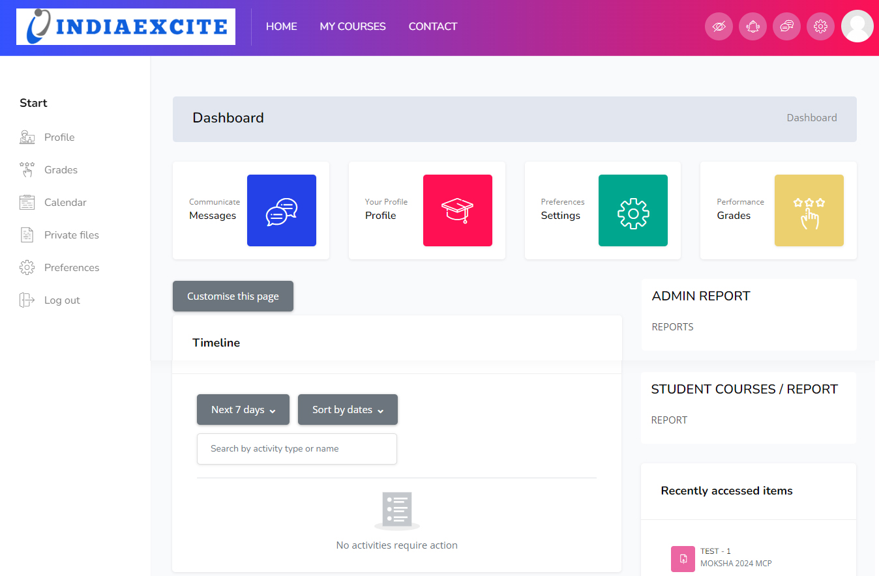
Student Module Highlights – PERSONALIZED DASHBOARD

Slide 26
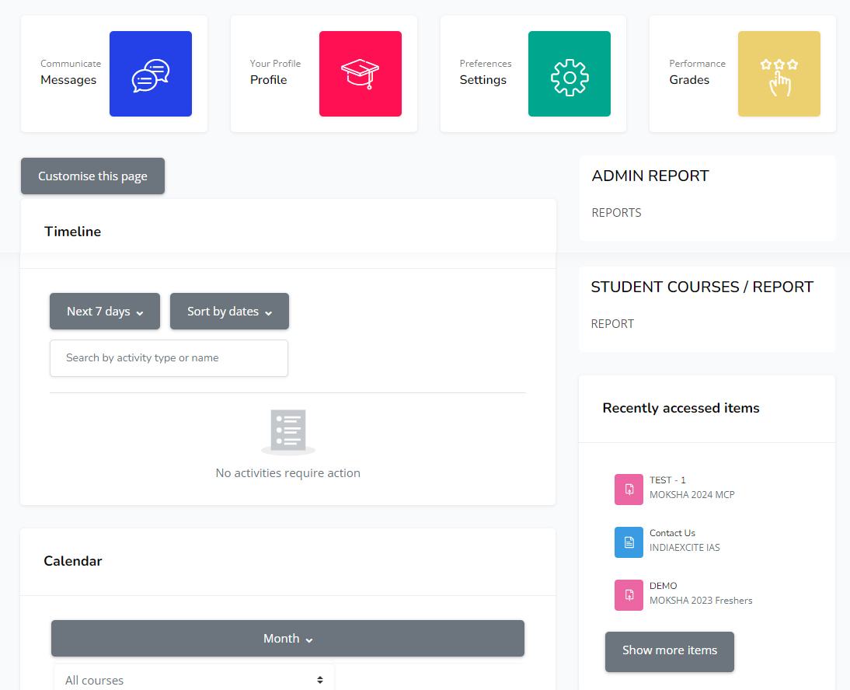
Student Module Highlights – LEARNING TOOLS

Slide 27
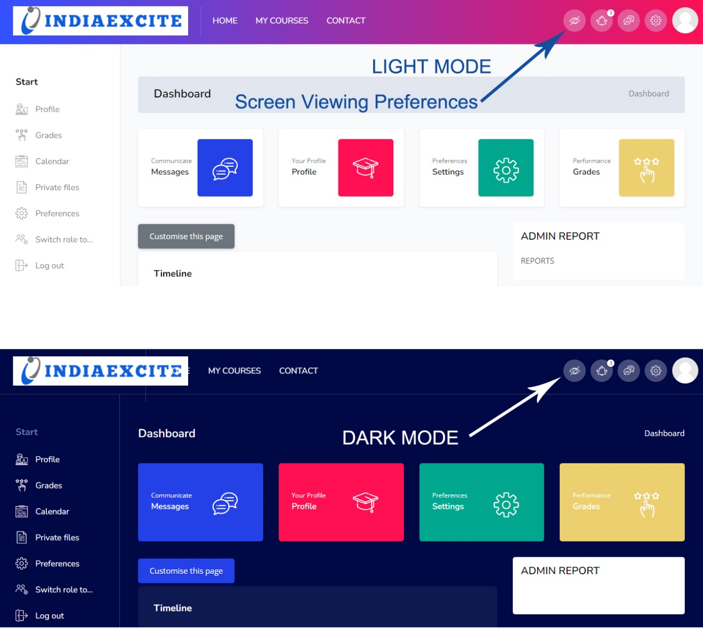
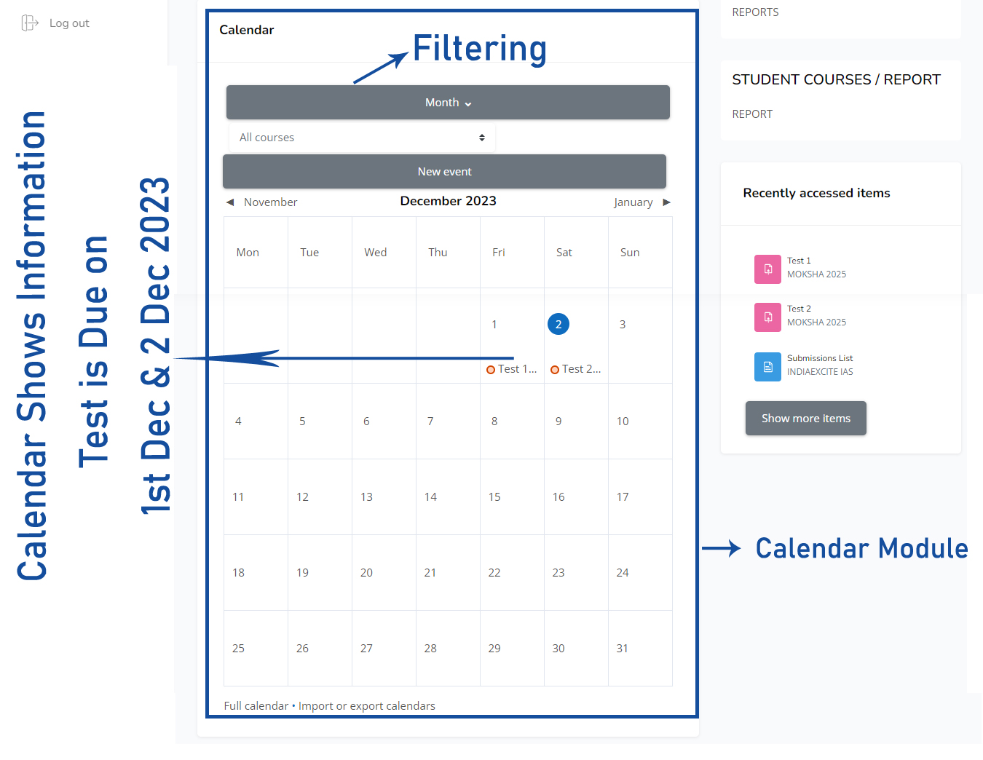
Student Module Highlights – CUSTOMIZATION OPTIONS

Slide 28
Admin Module Features
Enhanced Dashboard:
Online and logged-in user modules
Advanced Course Management:
Course creation, restoration, and custom field management.
Detailed Reports:
Submission lists, marks reports, and question-wise performance.

Slide 29
Admin Module Features – ENHANCED DASHBOARD

Slide 30
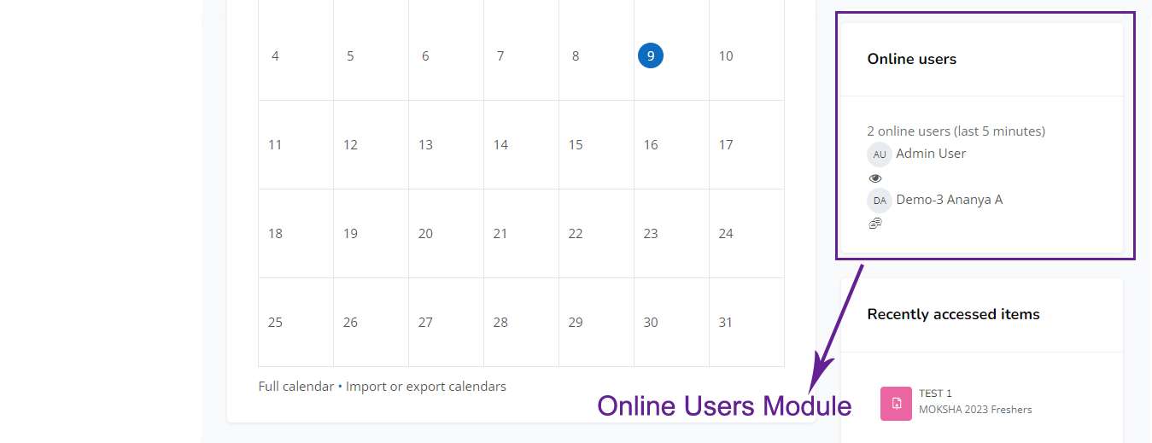
Admin Module Features – LOGGED IN USER MODULE

Slide 31
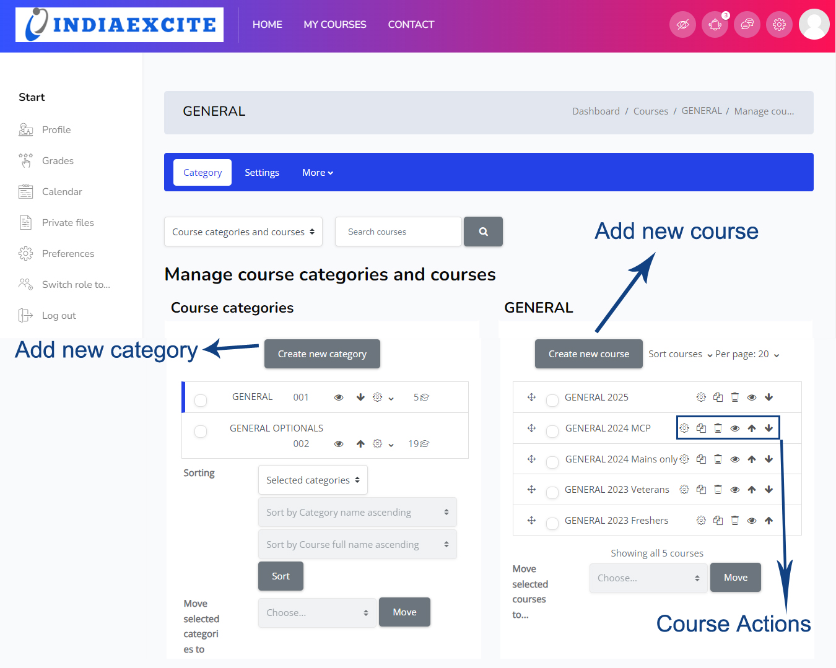
Admin Module Features – COURSE MANAGEMENT

Slide 32
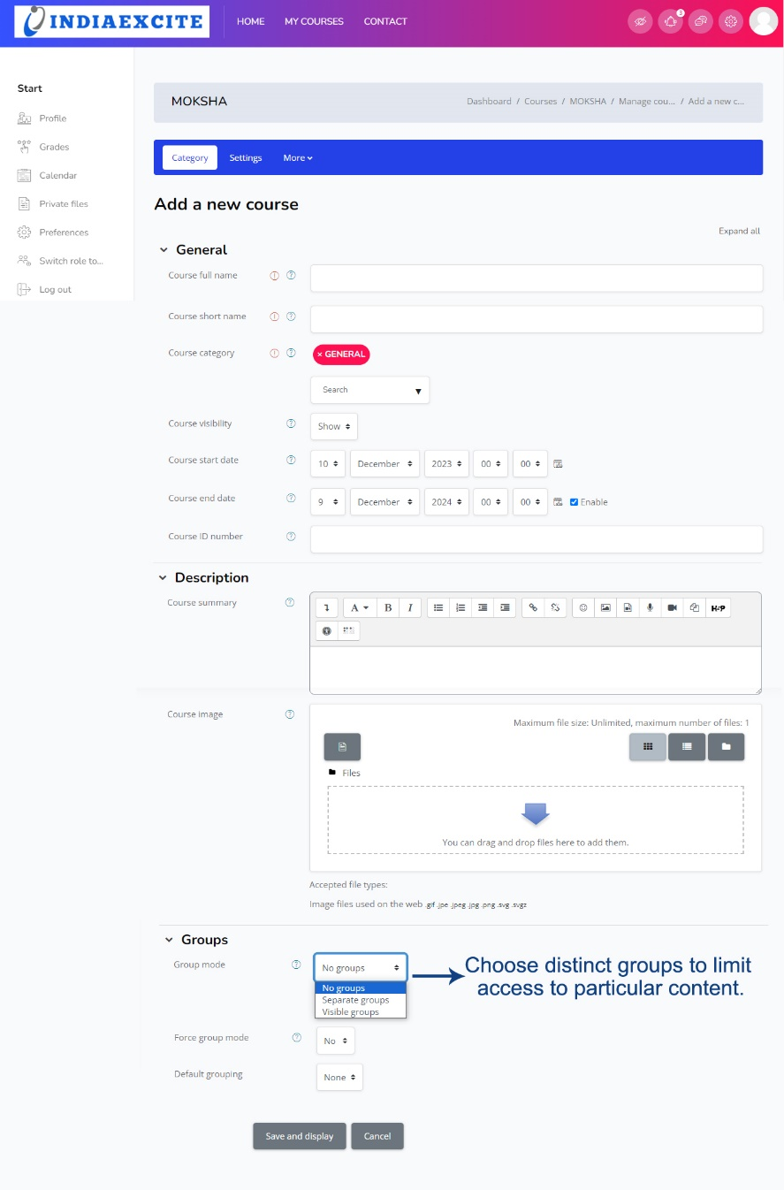
Admin Module Features – CREATE COURSE

Slide 33
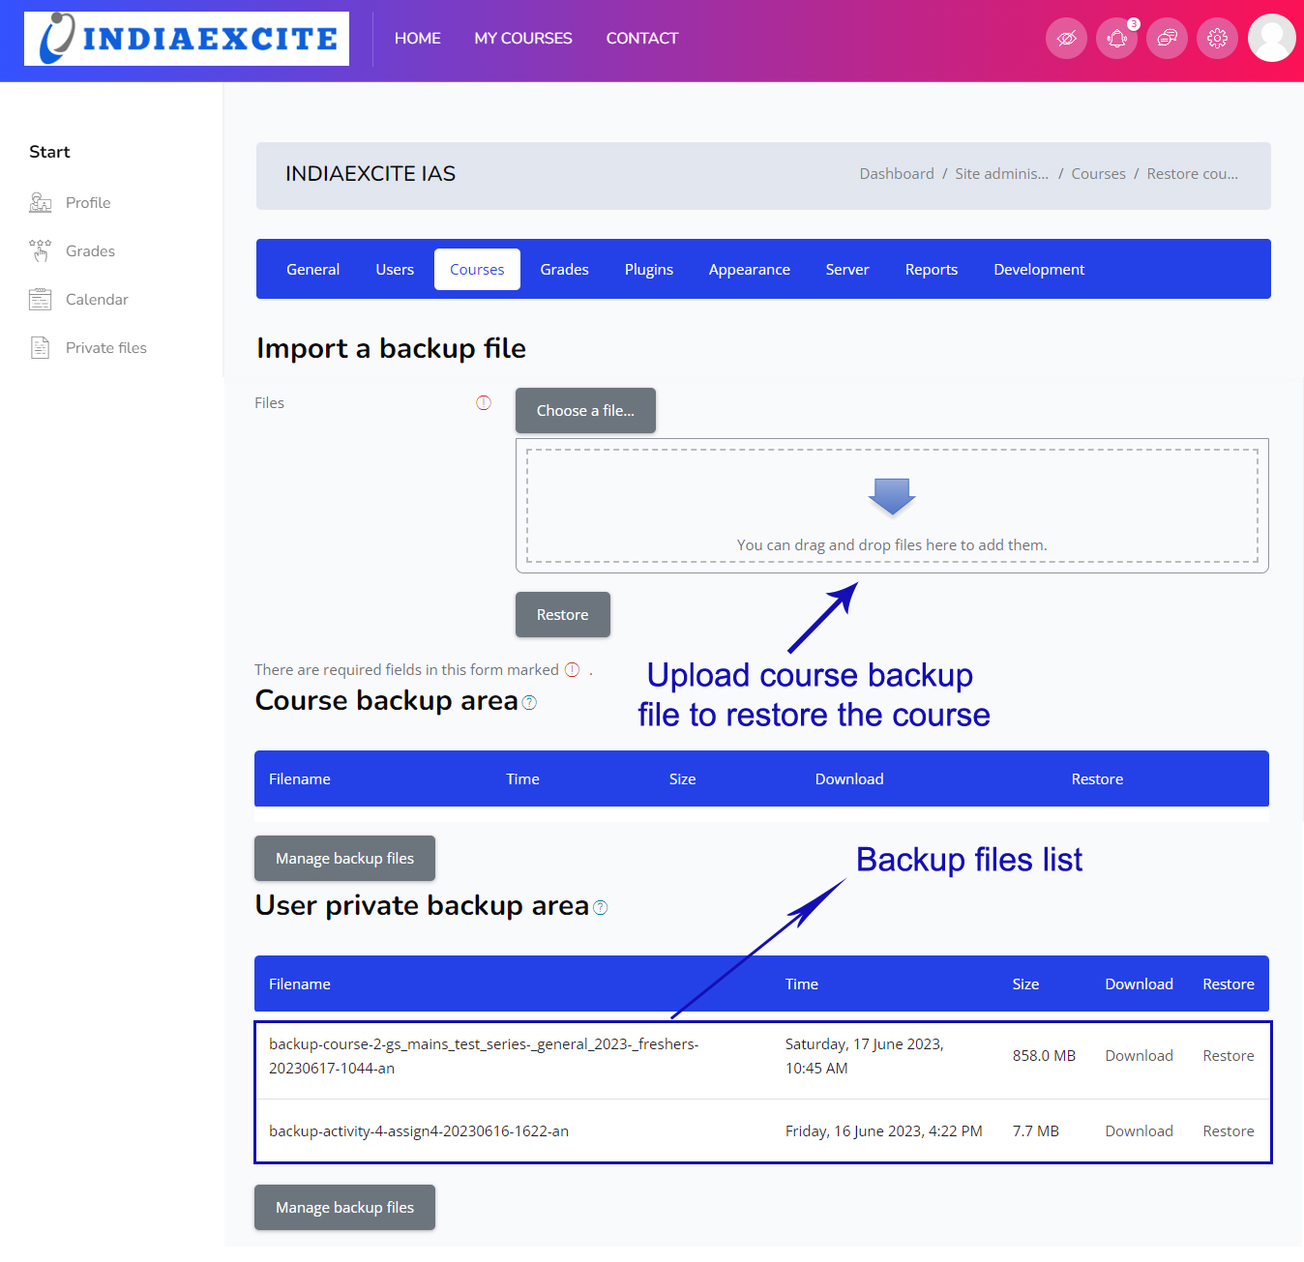
Admin Module Features – RESTORE COURSE

Slide 34
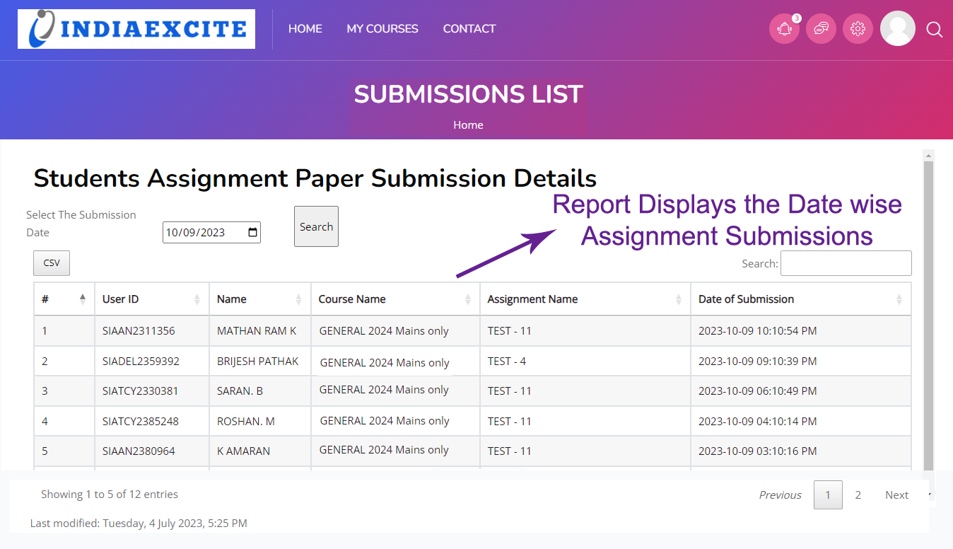
Admin Module Features – DETAILED REPORTS

Slide 35
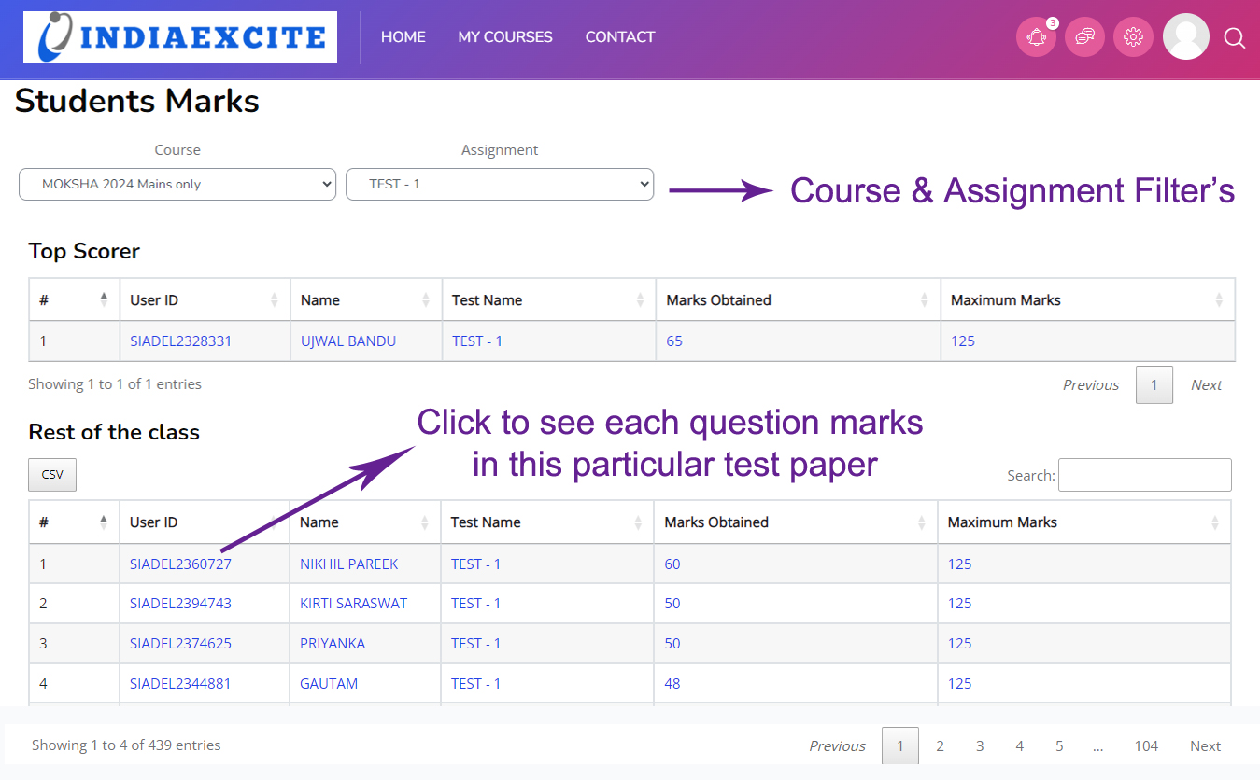
Admin Module Features – DETAILED REPORTS

Slide 36
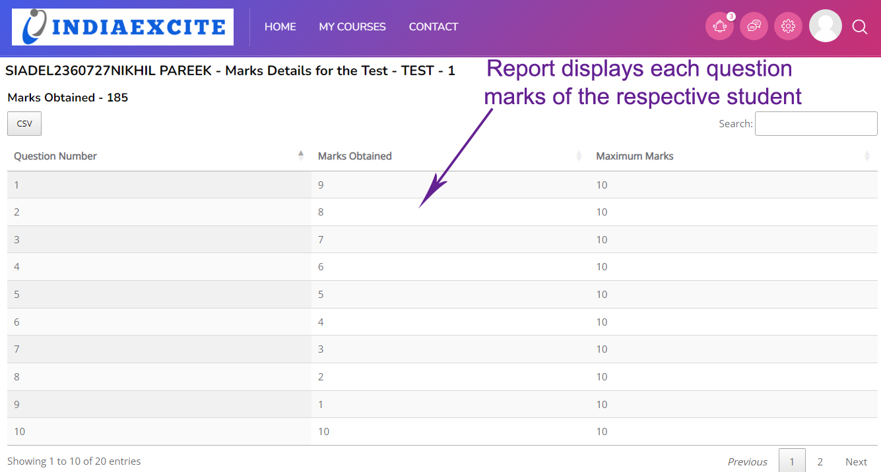
Admin Module Features – DETAILED REPORTS

Slide 37
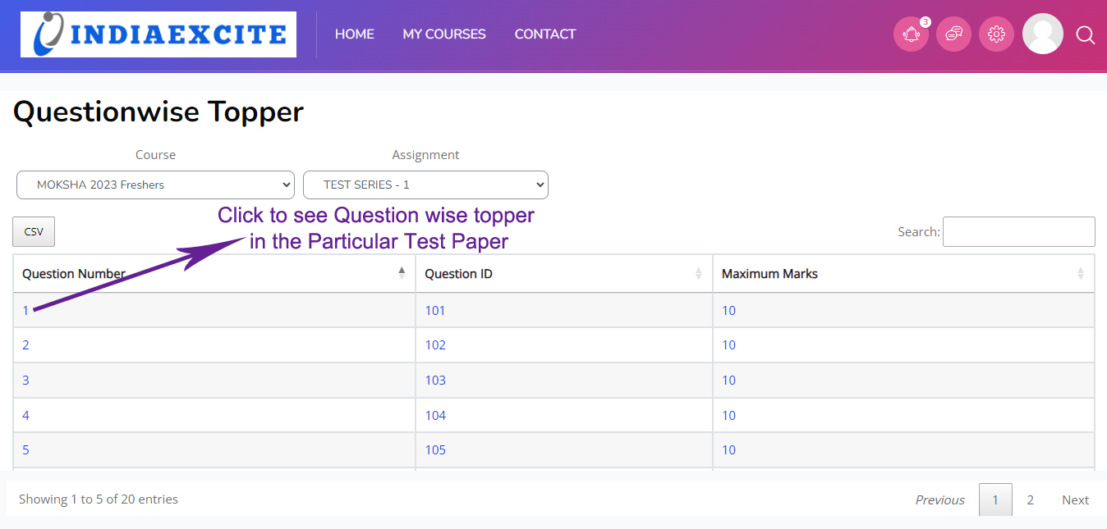
Admin Module Features – DETAILED REPORTS

Slide 38
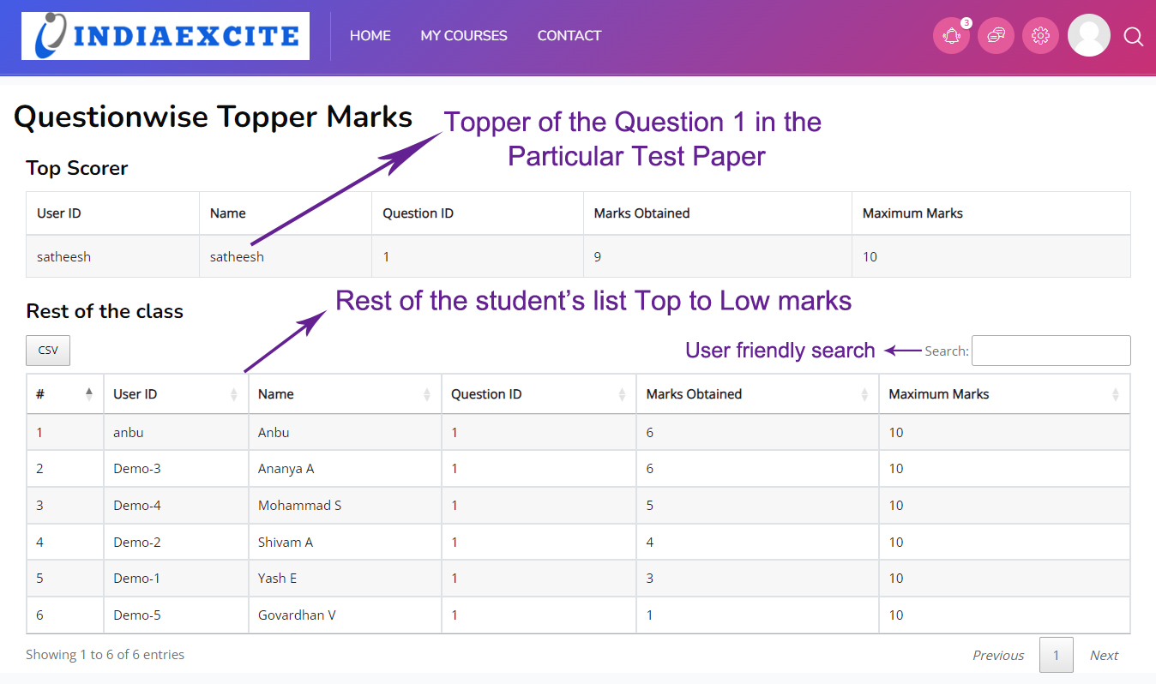
Admin Module Features – DETAILED REPORTS

Slide 39
Backend Administration
User Management:
Account creation, permissions, and cohort enrollments.
Course Management:
Custom fields, category management, and course backups.
Appearance and Reports:
Dashboard customization and real-time log access.

Slide 40
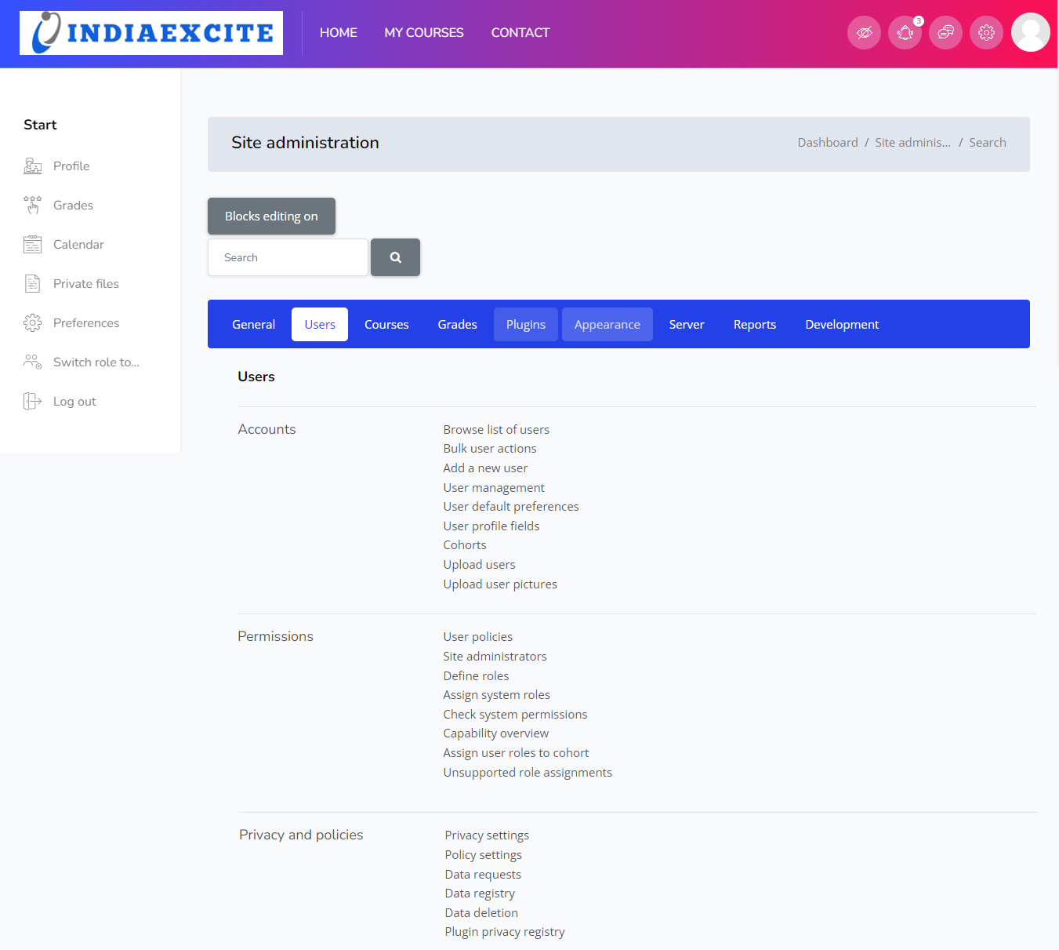
Backend Administration

Slide 41
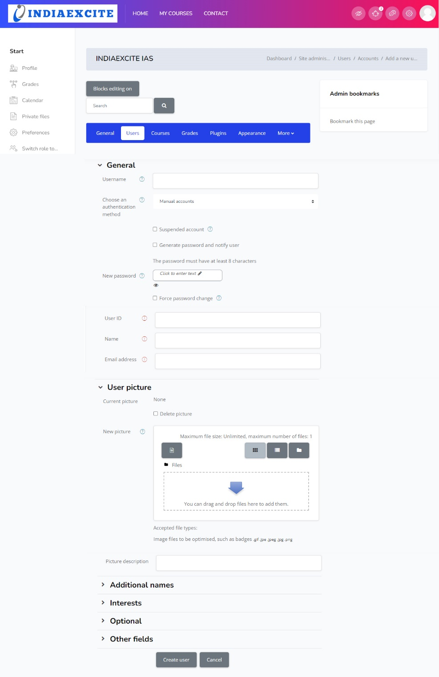
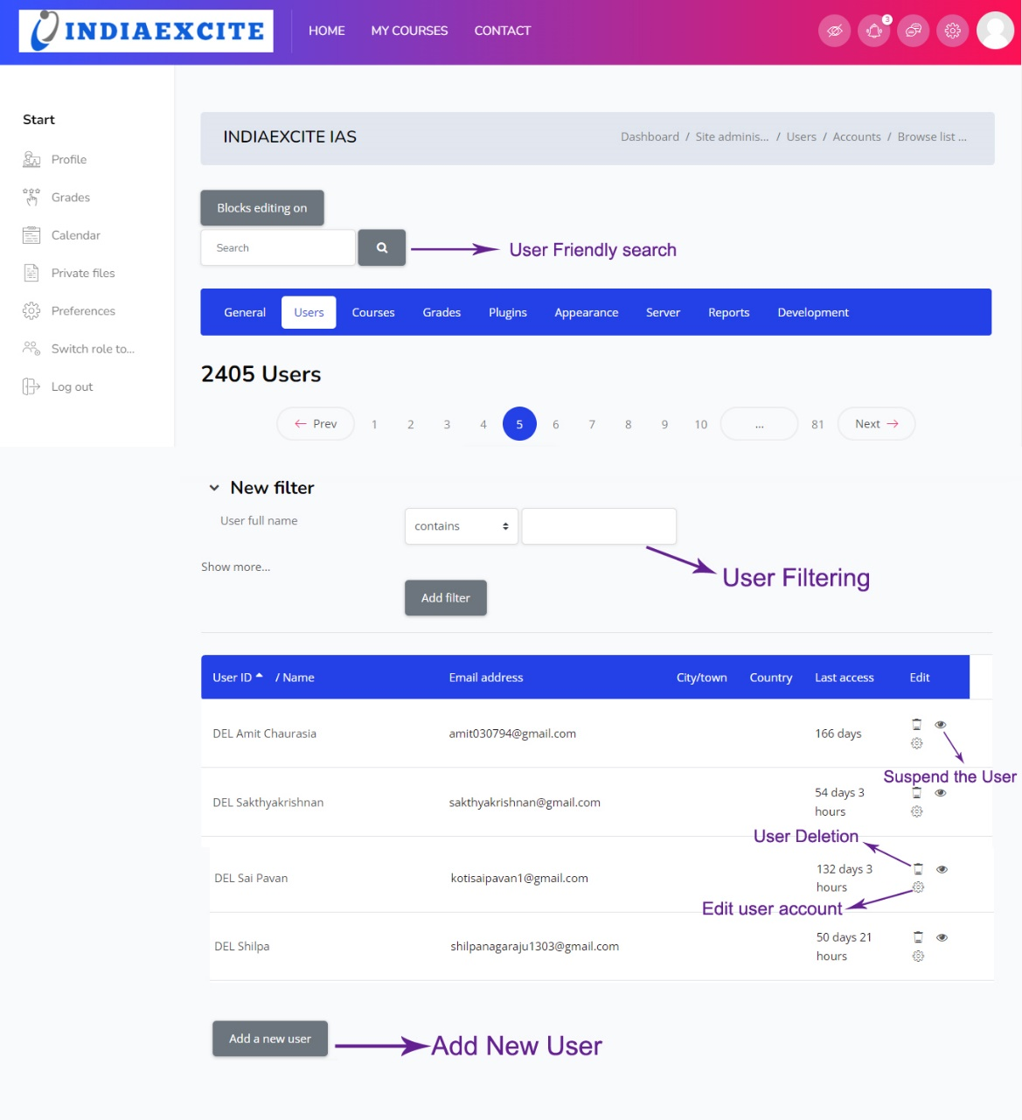
Backend Administration

Slide 42
Backend Administration

Slide 43
Backend Administration

Slide 44
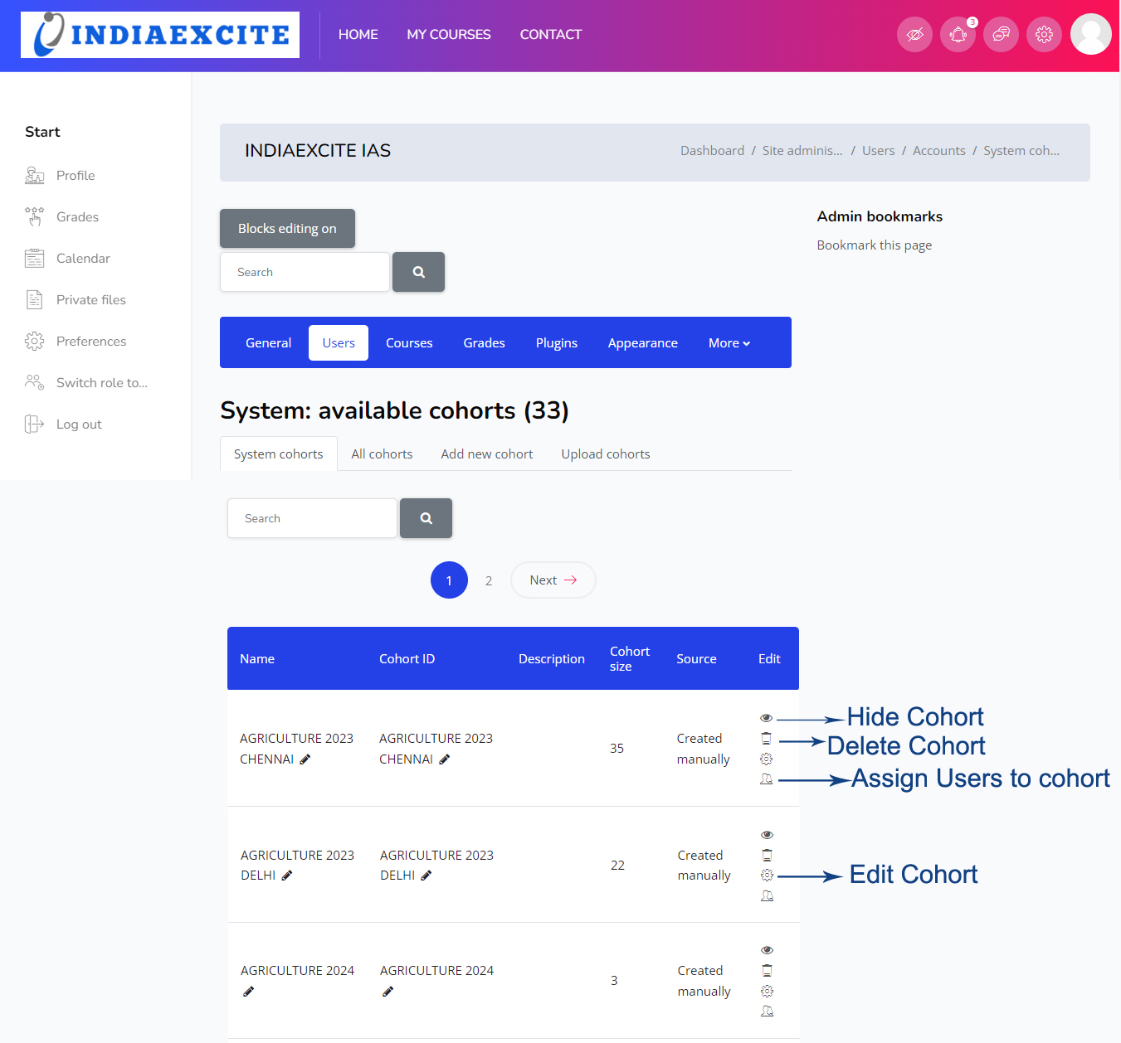
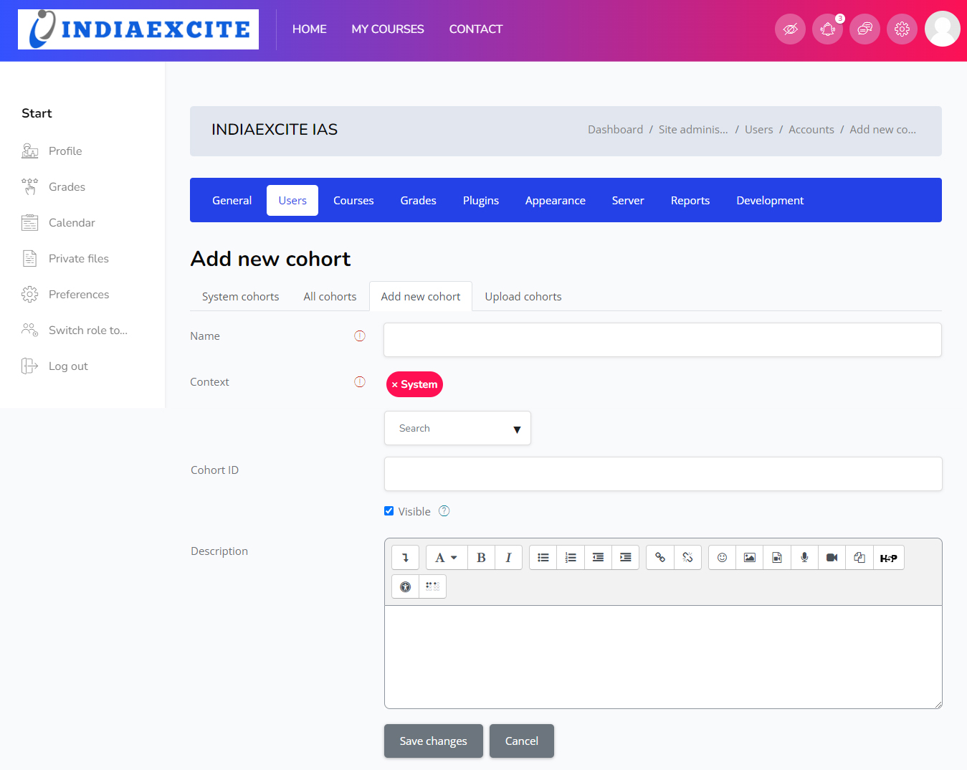
Backend Administration

Slide 45
Backend Administration

Slide 46
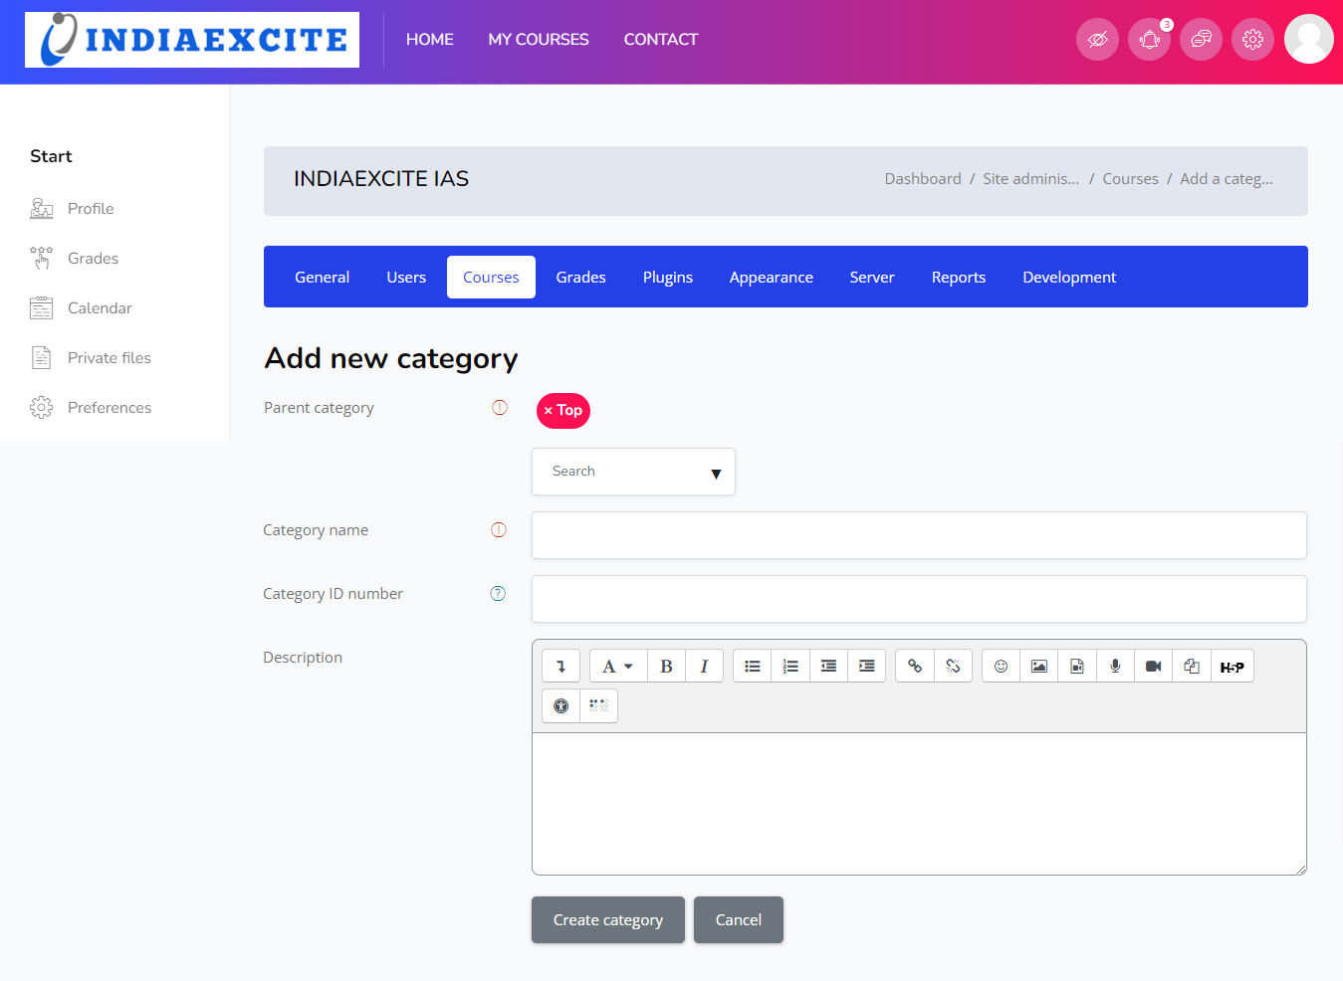
Backend Administration

Slide 47
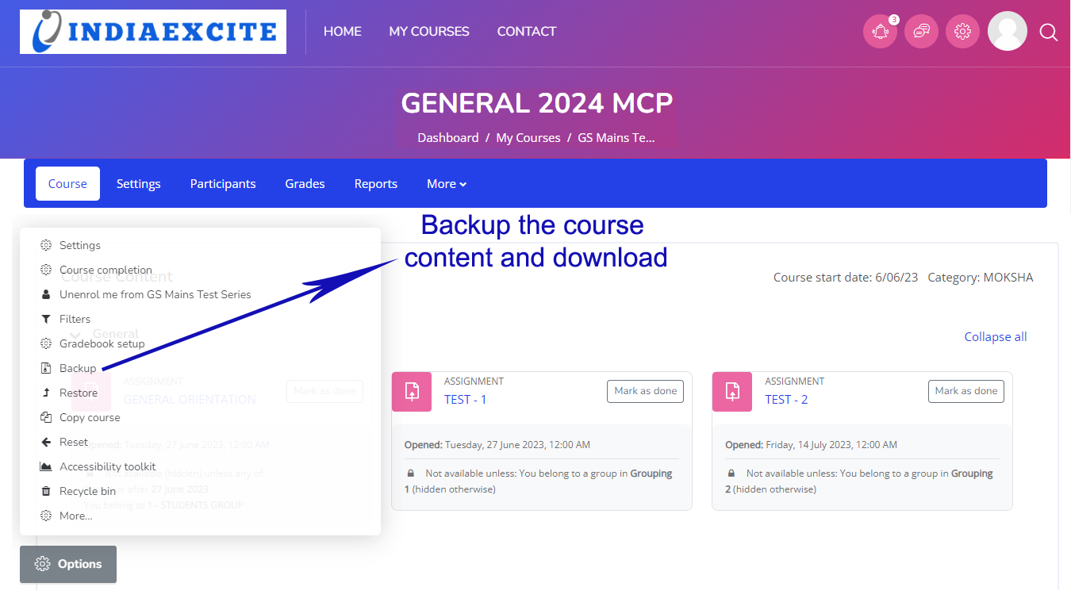
Backend Administration

Slide 48
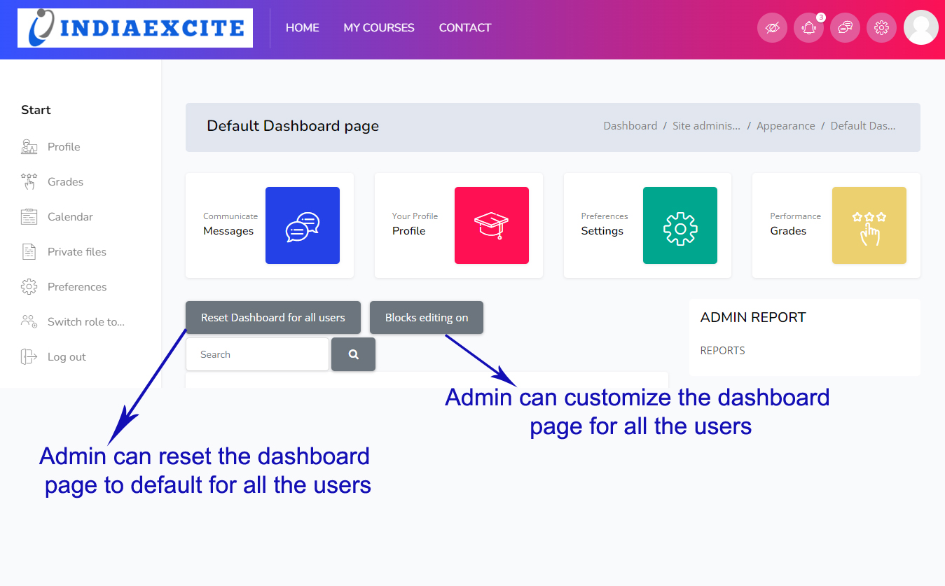
Backend Administration

Slide 49
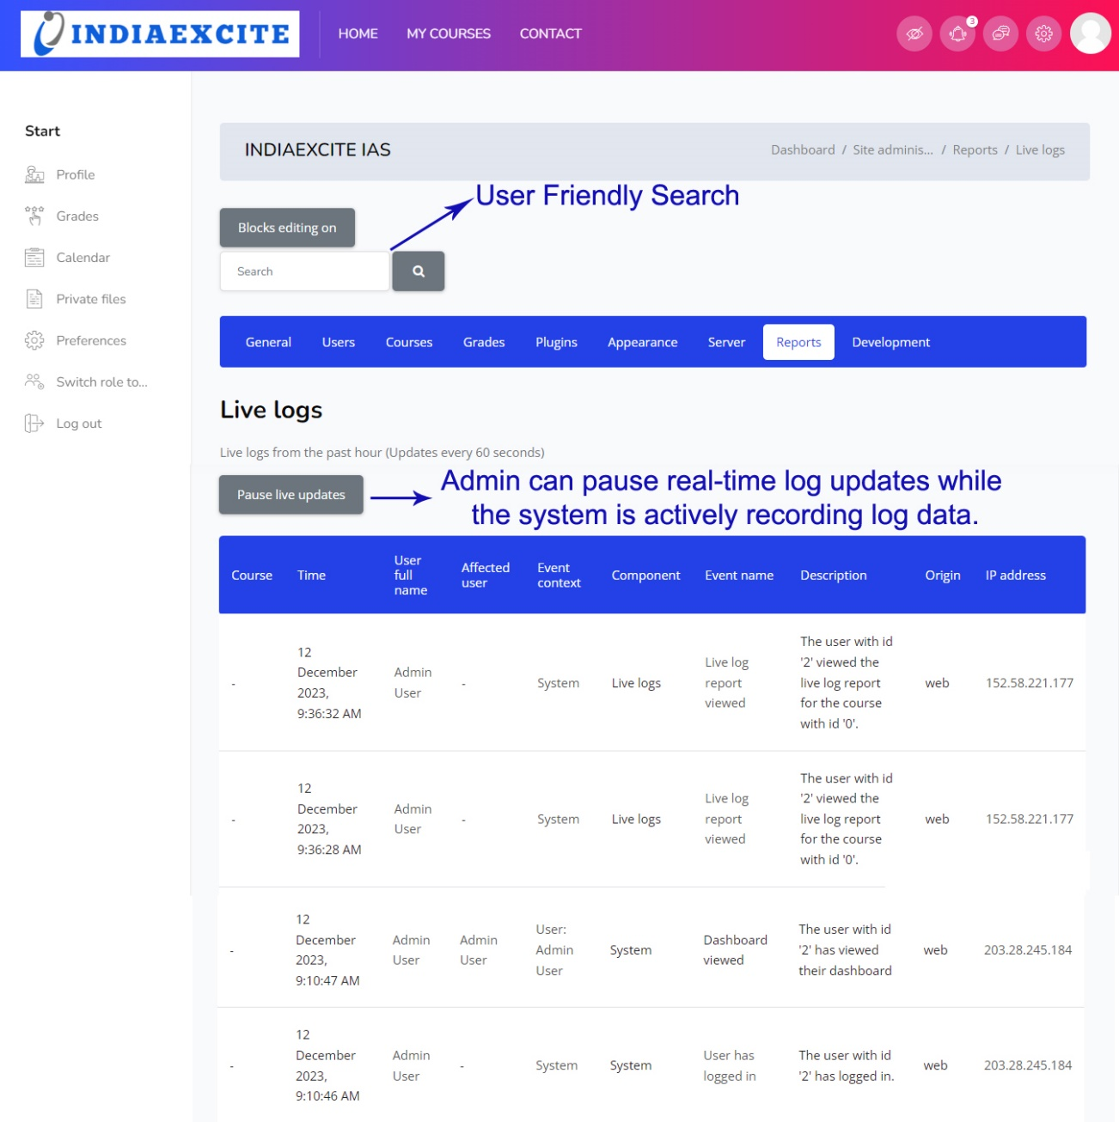
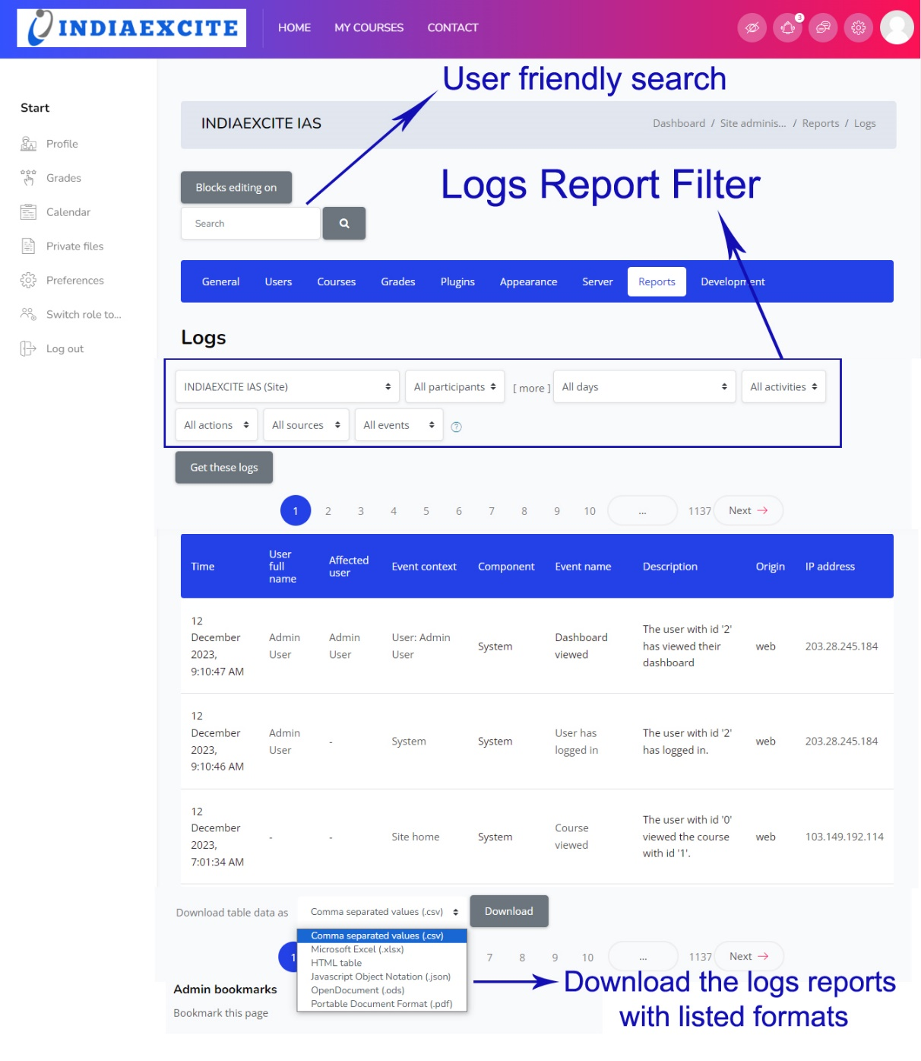
Backend Administration

Slide 50
Conclusion
Summary:
Comprehensive LMS solution combining digital and physical elements.
Robust assignment management, grading flexibility, and user customization
Call to Action:
Contact us for a demo and see how our customized LMS can streamline your educational needs.

