Slide 1
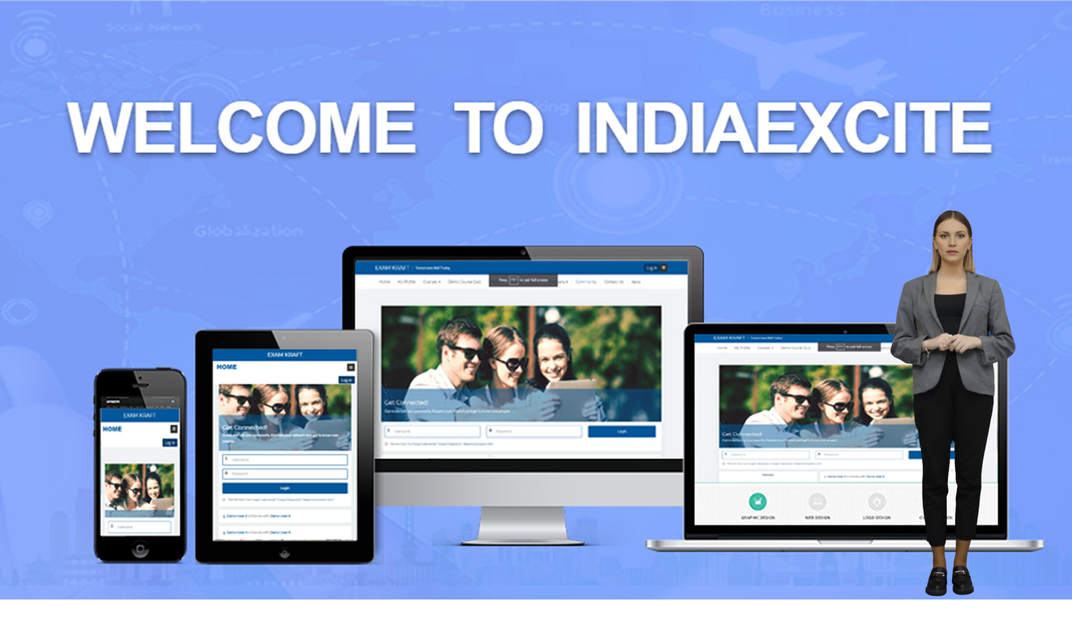


Slide 2













BUSINESS OVERVIEW
Establishment
INDIAEXCITE - 2022
Company
Indiaexcite IT Solutions Pvt Ltd
Brand
INDIAEXCITE
Focus
LMS - Transforming University Education
Seamless Integration with Any System
Universal API Connector
AI Based – Mentor Bots
Personalized guidance - 24/7 availability - instant responses
Zoom Integration for Virtual Classes
Seamless zoom integration for virtual classes
Advanced Assessment and Grading
Versatile assessments: quizzes/mcqs, assignments, peer reviews
Detailed Feedback
Provide detailed assignment feedback for student improvement
Mobile Learning
Mobile App for courses, push notifications, assignments, deadlines
Integration with Third-Party Tools
Library resources, external applications for enhanced learning
Robust Analytics and Reporting
Track student performance, engagement metrics, detailed analytics, custom reports.

Slide 3

Indiaexcite's LMS:
Transforming University Education

Slide 4

Key Features of Indiaexcite's LMS
Indiaexcite's Learning Management System (LMS) is designed to revolutionize how universities engage with students, streamline academic processes, and enhance the overall educational experience. Let's explore the incredible features and benefits that make Indiaexcite's LMS the perfect choice for your university.

Slide 5


1. AI-Based Mentor Bots
Personalized Guidance: Our AI-based mentor bots offer personalized academic guidance, helping students navigate their courses, assignments, and academic goals. 24/7 Availability: These bots are available round the clock, ensuring students get the support they need anytime, anywhere.
Instant Responses: Quick answers to frequently asked questions, helping reduce the workload on faculty and support staff.

Slide 6

2. Zoom Integration for Virtual Classes
Seamless Integration: The LMS integrates smoothly with Zoom, facilitating effortless scheduling and conducting of virtual classes. Interactive Sessions: Enables live interaction between students and instructors, fostering a more engaging learning environment.
Recorded Sessions: Automatic recording of sessions allows students to revisit lectures and review materials at their convenience.

Slide 7


3. User-Friendly Interface
Intuitive Design: The LMS features an intuitive and user-friendly interface, making navigation simple for both students and faculty. Responsive Layout: Optimized for various devices, ensuring a consistent experience on desktops, tablets, and smartphones.

Slide 8

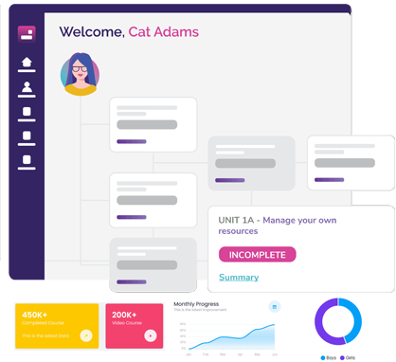
4. Comprehensive Course Management
Course Creation and Management: Easily create, organize, and manage courses with a wide array of tools and options. Content Variety: Support for multiple content types, including videos, documents, quizzes, and interactive activities.
Modular Structure: Allows for a modular course structure, making it easier to update and manage course content

Slide 9

5. Enhanced Communication Tools
Discussion Forums: Create interactive forums where students and instructors can discuss topics, share insights, and collaborate on projects. Messaging System: A built-in messaging system facilitates direct communication between students and faculty.
Announcements: Easily post announcements to keep everyone informed about important updates and events.

Slide 10


6. Advanced Assessment and Grading
Flexible Assessment Options: Support for various assessment types, including quizzes, assignments, and peer assessments. Automated Grading: Automated grading features for objective assessments, saving time and ensuring consistency.
Detailed Feedback: Provide detailed feedback on assignments to help students understand their strengths and areas for improvement.

Slide 11


7. Robust Analytics and Reporting
Student Performance Tracking: Track student performance and progress through detailed analytics and reports.
Engagement Metrics: Measure student engagement to identify areas where additional support might be needed.
Custom Reports: Generate custom reports to meet specific institutional requirements and gain insights into academic trends.

Slide 12

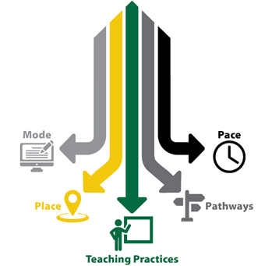
8. Flexible Learning Paths
Personalized Learning: Create personalized learning paths to cater to individual student needs and learning styles.
Self-Paced Learning: Support for self-paced courses, allowing students to learn at their own pace.
Blended Learning: Combine online and offline learning experiences for a comprehensive educational approach.

Slide 13


9. Secure and Scalable
Data Security: Advanced security measures to protect sensitive student and institutional data.
Scalability: Scalable infrastructure to accommodate the growing needs of a university, ensuring reliable performance even with a large number of users.

Slide 14
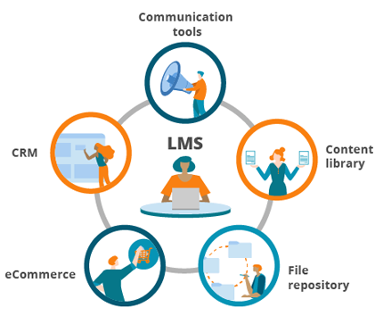
10. Integration with Third-Party Tools
Library Resources: Integrate with digital library resources to provide students easy access to academic materials.
External Applications: Support for integration with various third-party applications and tools to enhance the learning experience.

Slide 15

11. Mobile Learning
Mobile App: A dedicated mobile app ensures that students can access their courses and materials on the go.
Push Notifications: Stay updated with real-time push notifications for announcements, assignments, and deadlines.

Slide 16
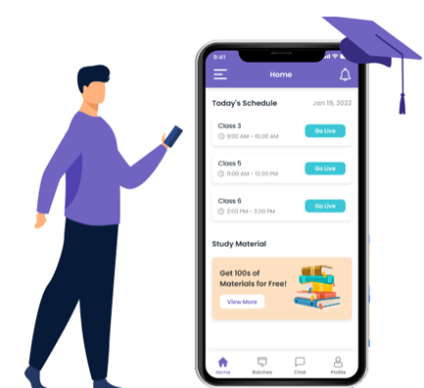
12. Customization and Branding
Customizable Interface: Customize the LMS interface to reflect your university's branding and identity.
Theme Options: Various theme options to tailor the look and feel of the LMS according to institutional preferences.

Slide 17

13. Student Collaboration Tools
Group Projects: Tools to facilitate group projects and collaborative assignments.
Peer Reviews: Peer review features enable students to give and receive feedback on their work.

Slide 18
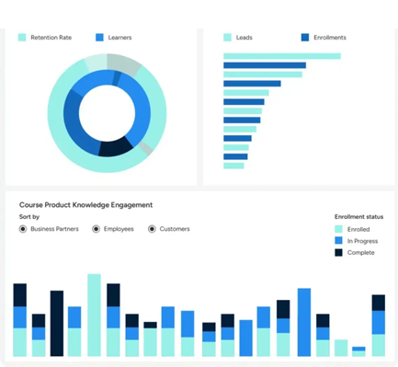
14. Learning Analytics Dashboard
Comprehensive Insights: Provides students and faculty with a visual dashboard to track learning progress, identify strengths and areas for improvement.
Real-Time Data: Access to real-time data and analytics to monitor engagement and performance metrics.

Slide 19


Why Choose Indiaexcite's LMS?

Slide 20


Student Engagement
Interactive Content: Engaging content types such as quizzes, gamified learning activities, and multimedia resources.
Collaborative Learning: Foster a sense of community and collaboration among students through forums and group activities.

Slide 21


Faculty Empowerment
Ease of Use: Simplify course management and grading processes, allowing faculty to focus more on teaching.
Professional Development: Continuous support and resources for faculty to enhance their teaching methods and utilize the LMS effectively.

Slide 22

Institutional Efficiency
Centralized Management: Streamline administrative tasks and course management through a centralized system.
Data-Driven Decisions: Leverage analytics to make informed decisions and improve educational outcomes.

Slide 23

Future-Ready Education
Innovative Features: Stay ahead with cutting-edge features like AI-based mentor bots and virtual class integration.
Adaptability: Easily adapt to changing educational needs and trends with a flexible and robust LMS.
Indiaexcite's LMS is not just a platform; it's a comprehensive solution designed to enhance the learning experience, streamline academic processes, and empower both students and faculty. By choosing Indiaexcite's LMS, your university is investing in a future-ready educational environment that prioritizes engagement, efficiency, and excellence.

Slide 24

Future-Ready Education
Innovative Features: Stay ahead with cutting-edge features like AI-based mentor bots and virtual class integration.
Adaptability: Easily adapt to changing educational needs and trends with a flexible and robust LMS.

Slide 25

CONTACT
FOR BUSINESS DISCUSSION CONTACT:
VENKATACHALAM CHINNIAH
CHIEF TECHNOLOGY OFFICER
INDIAEXCITE IT SOLUTIONS PVT LTD
PHONE: + 91 7299810303
EMAIL: venky@indiaexcite.net
Chennai – Tamilnadu – India
www.Indiaexcite.com
RANGANATHAN

