Slide 1
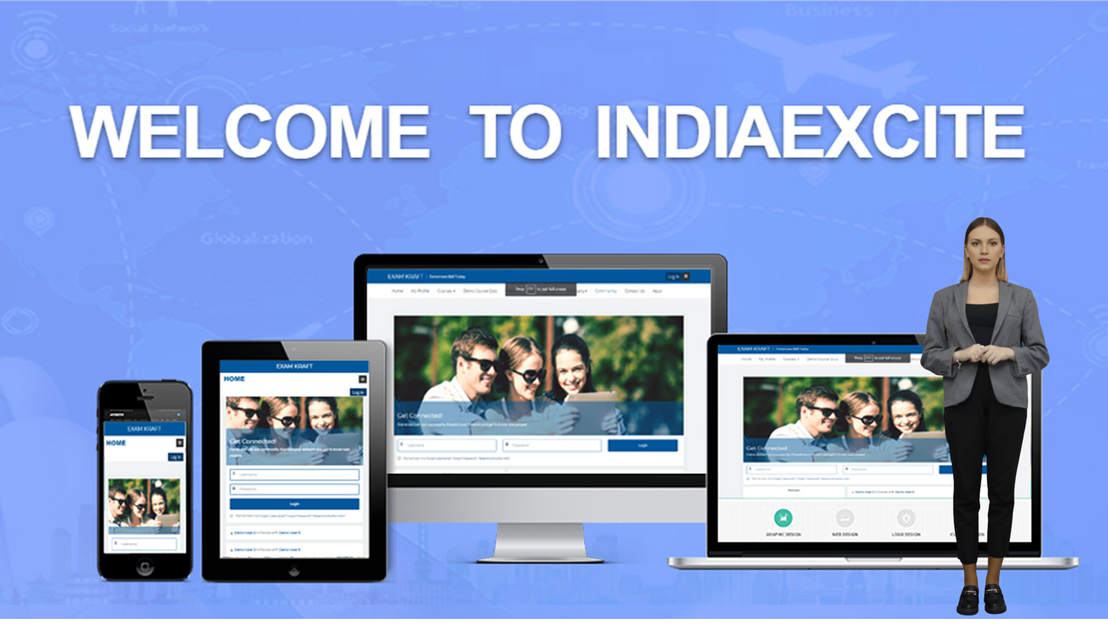


Slide 2













BUSINESS OVERVIEW
Establishment
INDIAEXCITE - 2022
Company
Indiaexcite IT Solutions Pvt Ltd
Brand
INDIAEXCITE
Focus
LMS - Transforming University Education
Seamless Integration with Any System
Universal API Connector
AI Based – Mentor Bots
Personalized guidance - 24/7 availability - instant responses
Zoom Integration for Virtual Classes
Seamless zoom integration for virtual classes
Advanced Assessment and Grading
Versatile assessments: quizzes/mcqs, assignments, peer reviews
Detailed Feedback
Provide detailed assignment feedback for student improvement
Mobile Learning
Mobile App for courses, push notifications, assignments, deadlines
Integration with Third-Party Tools
Library resources, external applications for enhanced learning
Robust Analytics and Reporting
Track student performance, engagement metrics, detailed analytics, custom reports.

Slide 3

Campus ERP System
Comprehensive Solution for Academic Management
Designed & Developed for Seamless Institutional Operations

Slide 4

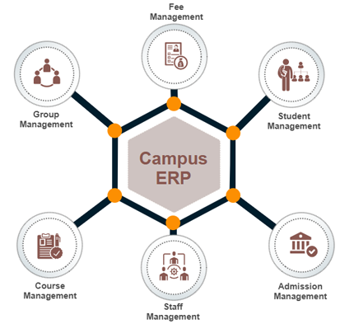
INTRODUCTION
The Campus ERP Application is designed based on inputs from multiple academies.
Successfully implemented at ISSM, Chennai.
Supports multiple academies under one management.
Integrates various modules for seamless operation.

Slide 5
LIST OF MODULES IN THE ERP
User Management
Campaign Module
Fee Module
Academic Management
Student Module
Student Assessment Module
Staff Management
Attendance Management
Placement Management
Reports

Slide 6

USER MANAGEMENT
Features
Create and manage users with different roles.
Assign roles: Administrator, Teaching Staff, Non-Teaching Staff, Students, HODs, Coordinators.
System functionality changes dynamically based on user roles.

Slide 7
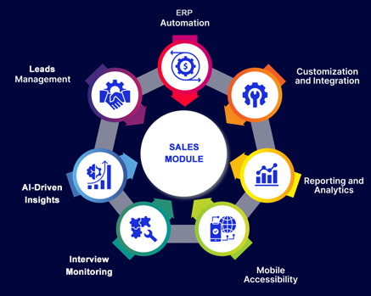
CAMPAIGN MODULE
Features
Tracks student inquiries and interactions.
Assigns leads to calling staff for follow-up.
Monitors multi-level interview process.
Generates Student ID upon successful admission.
Reports
Student leads assigned per staff.
Calls completed/pending.
Conversion insights.

Slide 8

STUDENT MODULE
Features
Student login for academic access.
Performance tracking: Marks, assignments, assessments.
Syllabus, timetable, exams.
Fees Tracking & Fee Payment.
Attendance, Leave, Gate pass Tracking.
Placement assistance: Job openings, interview schedules.

Slide 9

ACADEMIC MANAGEMENT
Features
Manages departments, courses, syllabus, timetables.
Exam and faculty management.
Updating Student’s Exam marks, Assessment grades.
Attendance and leave approval.
Academic content management.
Assessment, Assignment and Question bank upload
Reports
Student performance
Attendance
Faculty workload and schedules.

Slide 10

STAFF MANAGEMENT
Features
Categorizes staff: Teaching, Non-Teaching, HODs, Admins.
Assigns staff to departments.
Staff Attendance & Leave Tracking.
Manages timetables and schedules.

Slide 11

PLACEMENT MANAGEMENT
Features
Tracks company recruitment activities.
Assigns student placement coordinators.
Posts job descriptions and interview schedules.
Tracks placement results and student selections.
Reports
Companies participating.
Student placement statistics.

Slide 12

STUDENT ASSESSMENT MODULE
Features
Faculty can monitor and evaluate assessments.
Updating Credit score ( Grades ).
Reports
Student-wise assessment reports.
Assessment Grade reports.

Slide 13

ATTENDANCE MANAGEMENT
Features
Tracks student and staff attendance.
Faculty mark attendance per session.
Logs working hours and leaves.
Reports
Monthly/yearly attendance summaries.
Attendance percentage per student/staff.

Slide 14

LEAVE TRACKING
Features
Students apply for leave, OD, gate passes.
Staff apply for leave.
HOD/Admin handles approvals.
Reports
Leave history and balances.

Slide 15

FEE MODULE
Features
Generates fee structure based on course.
Logs payments and pending dues.
Loan, Scholarship, and Sponsorship System Integrated with External Payment Gateway.
Reports
Paid and pending fees.
Payment history and reminders.

Slide 16
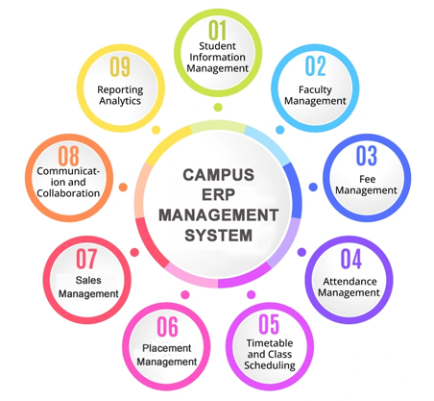
CONCLUSION
A complete solution for academic, financial, and administrative management.
Different branches and Multiple Universities under single identity.
Enhances operational efficiency.
Scalable for multiple academies.
Ensures seamless integration between departments.

Slide 17
APPLICATION SCREENSHOTS

Slide 18
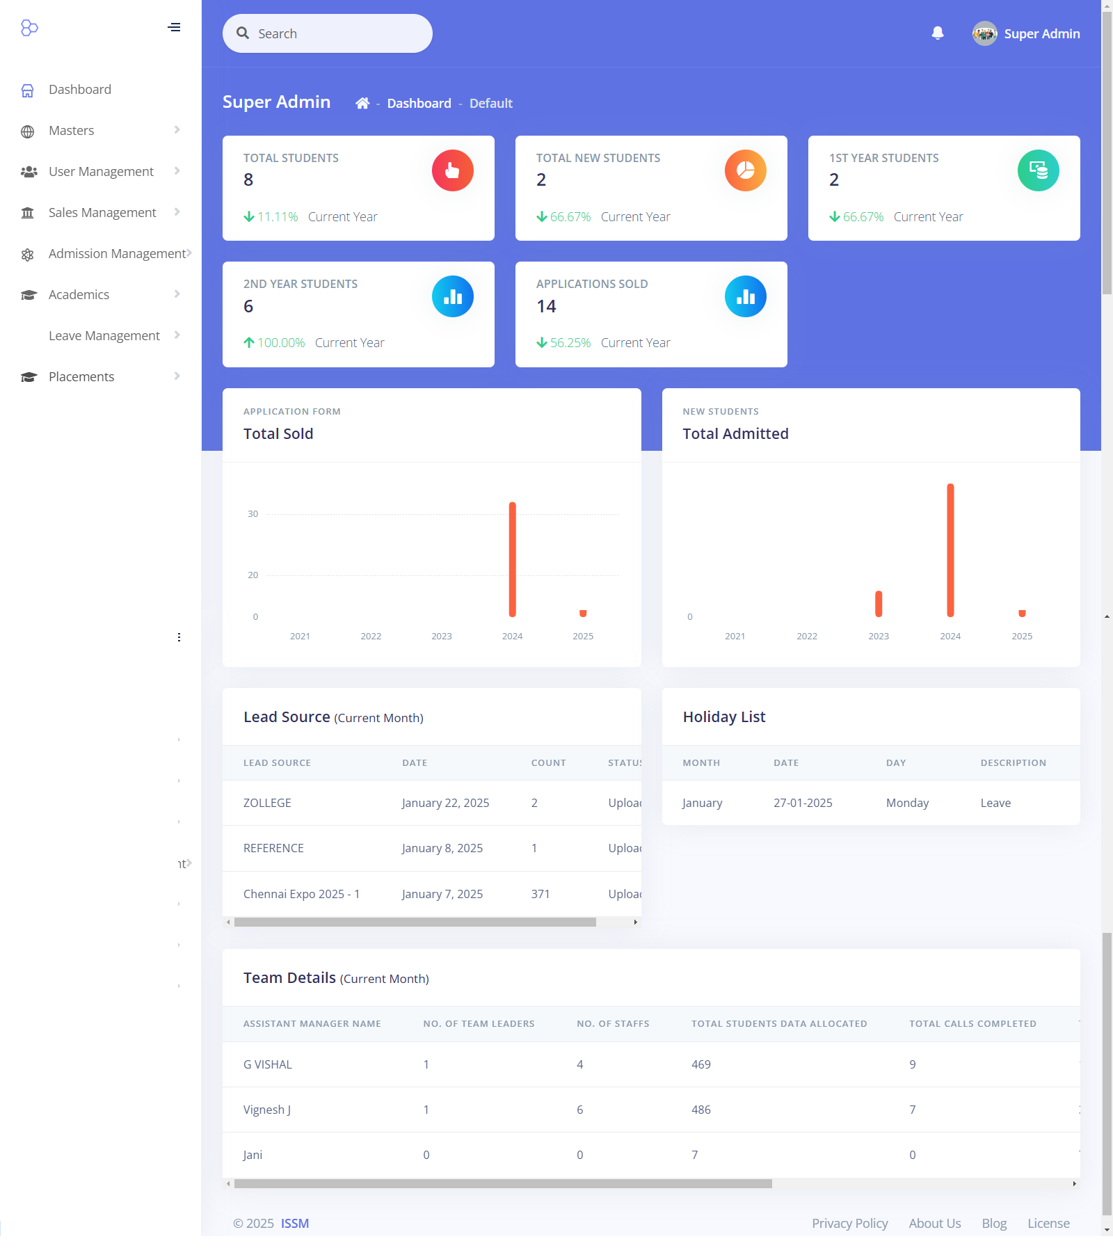

Slide 19
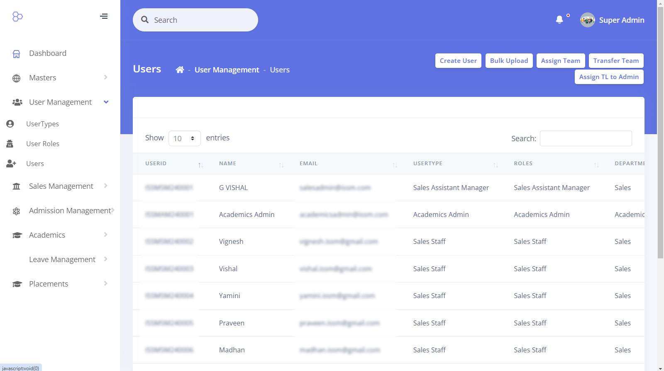

Slide 20
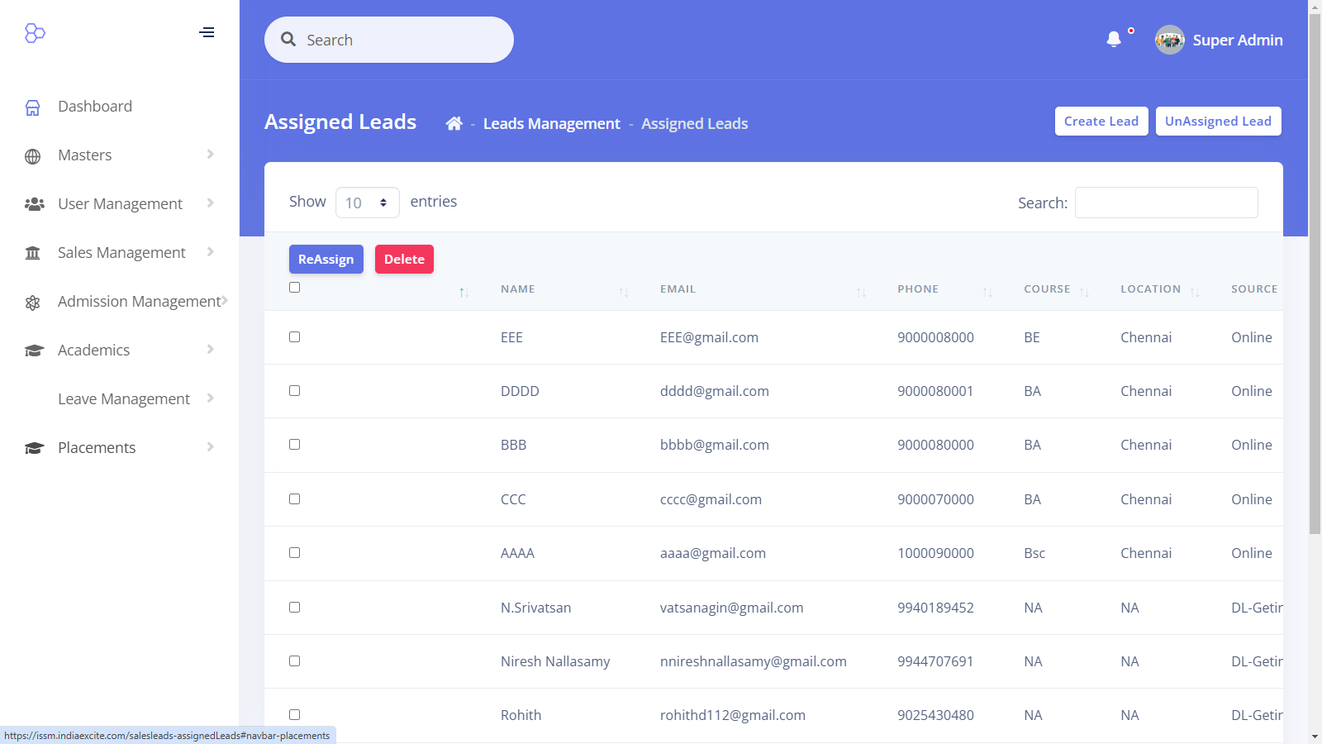

Slide 21
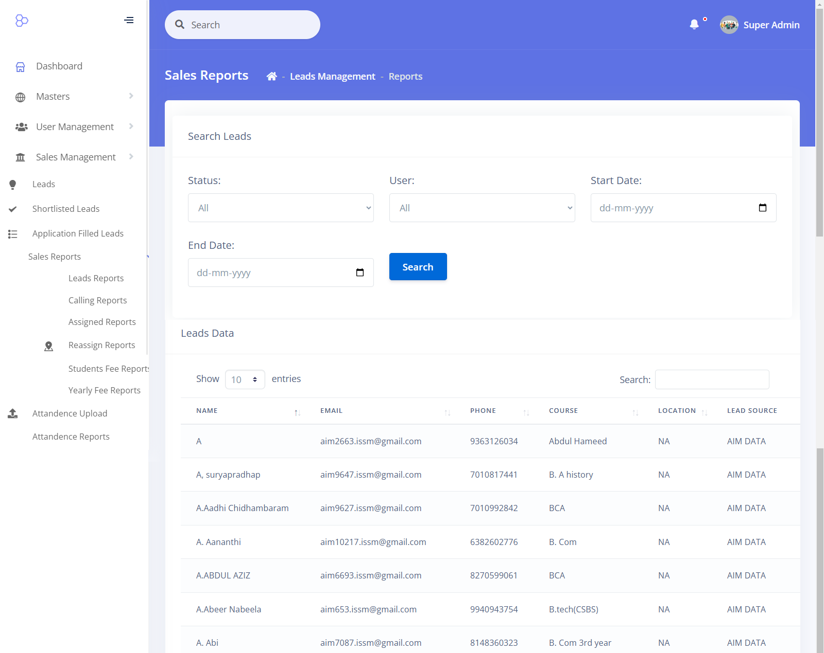

Slide 22
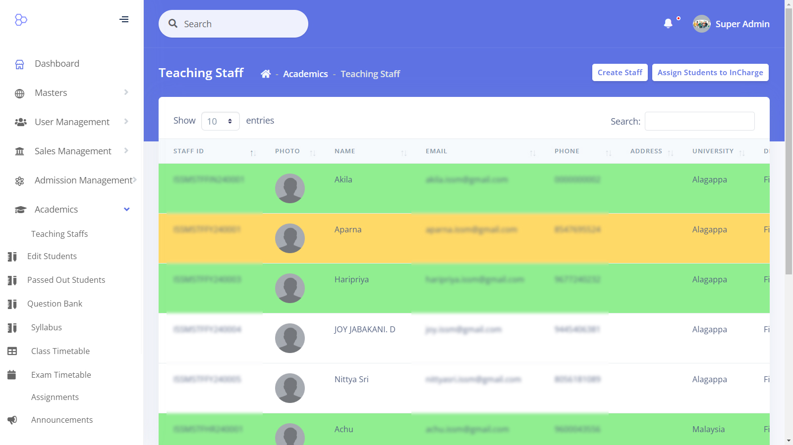

Slide 23
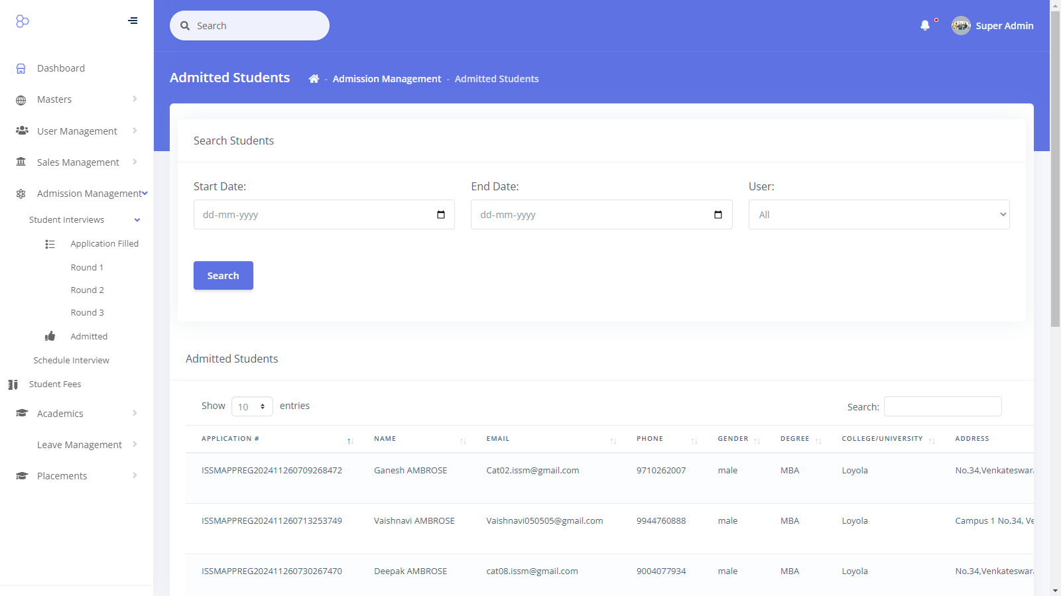

Slide 24
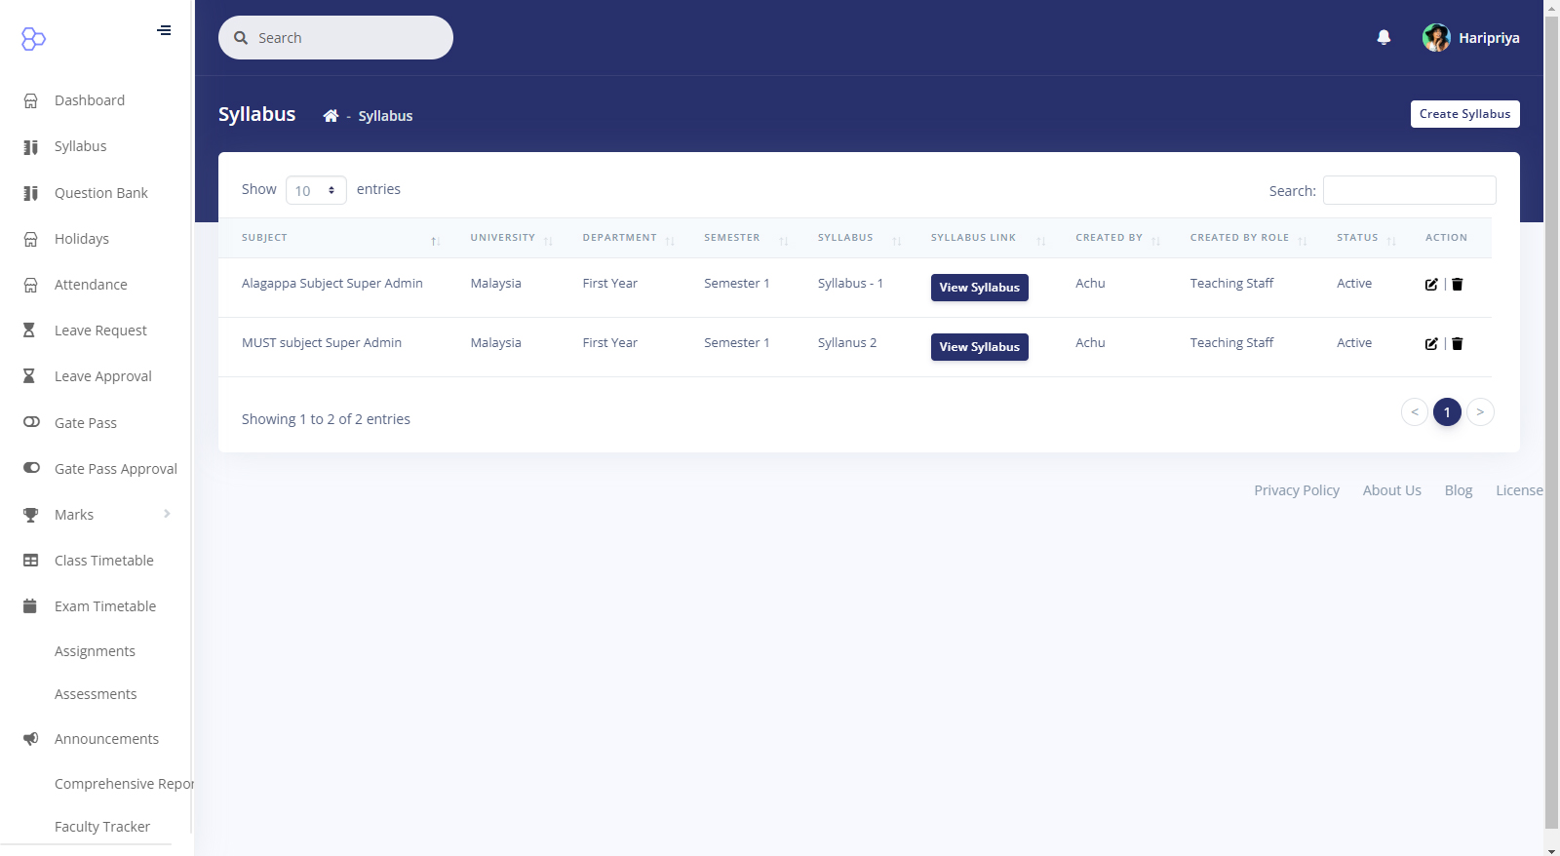

Slide 25
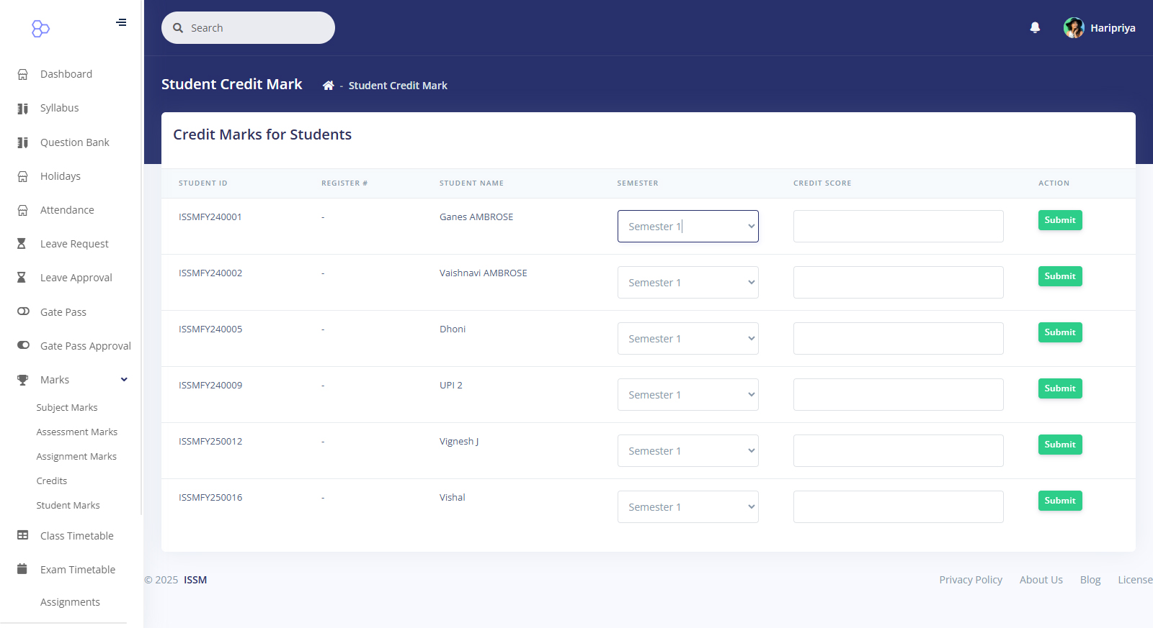

Slide 26
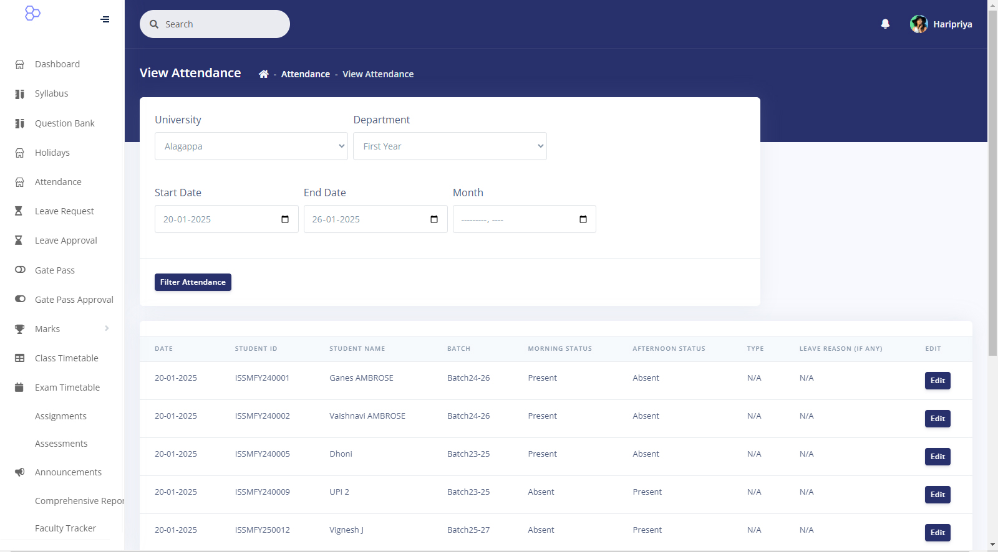

Slide 27
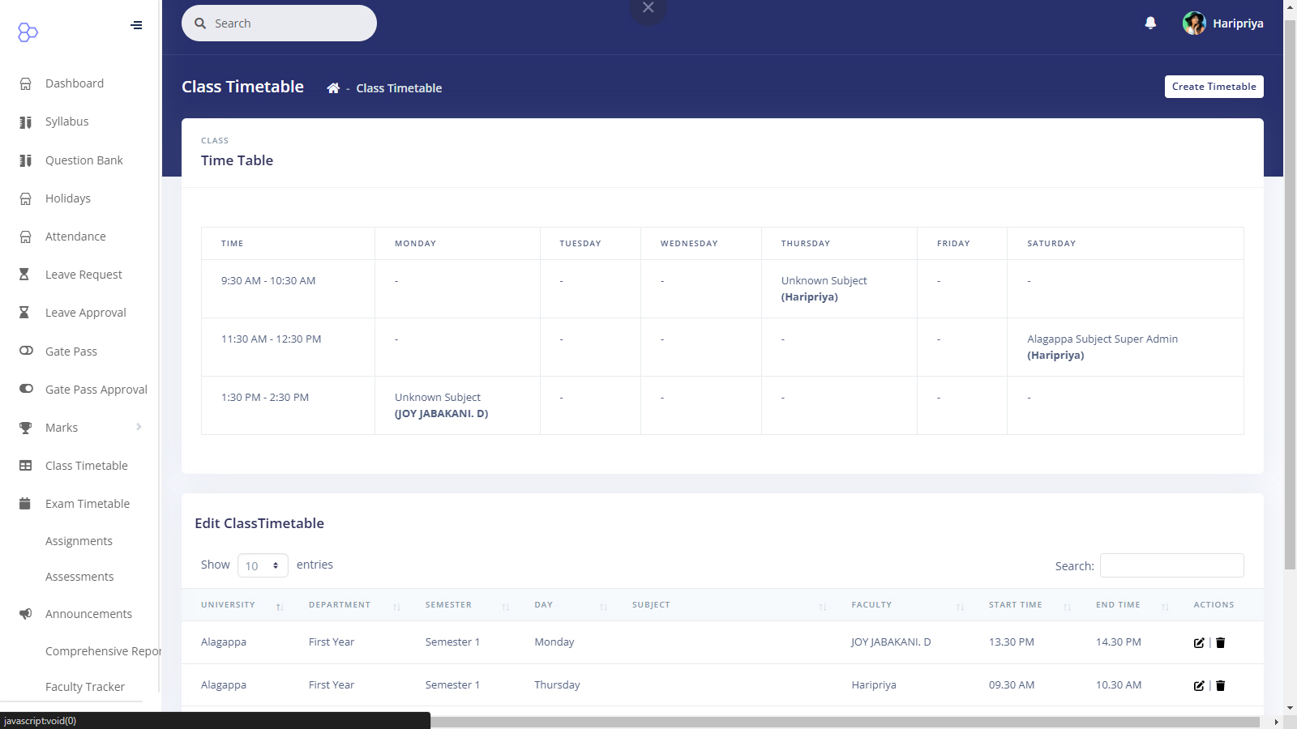

Slide 28
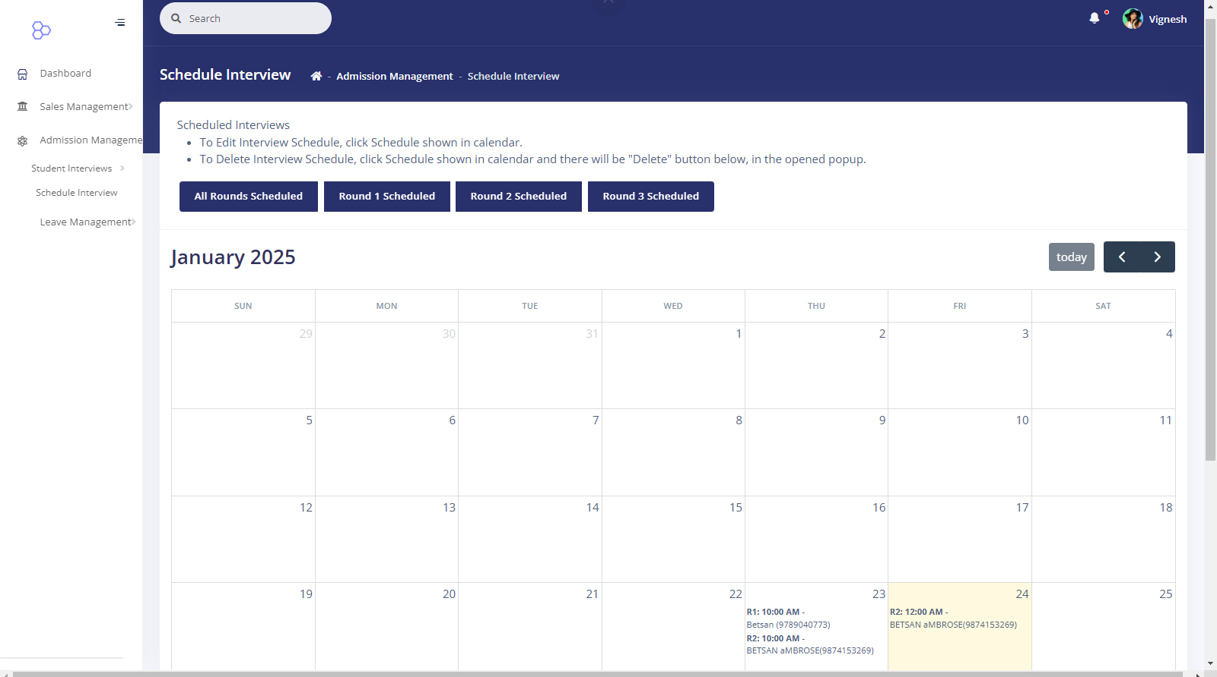

Slide 29
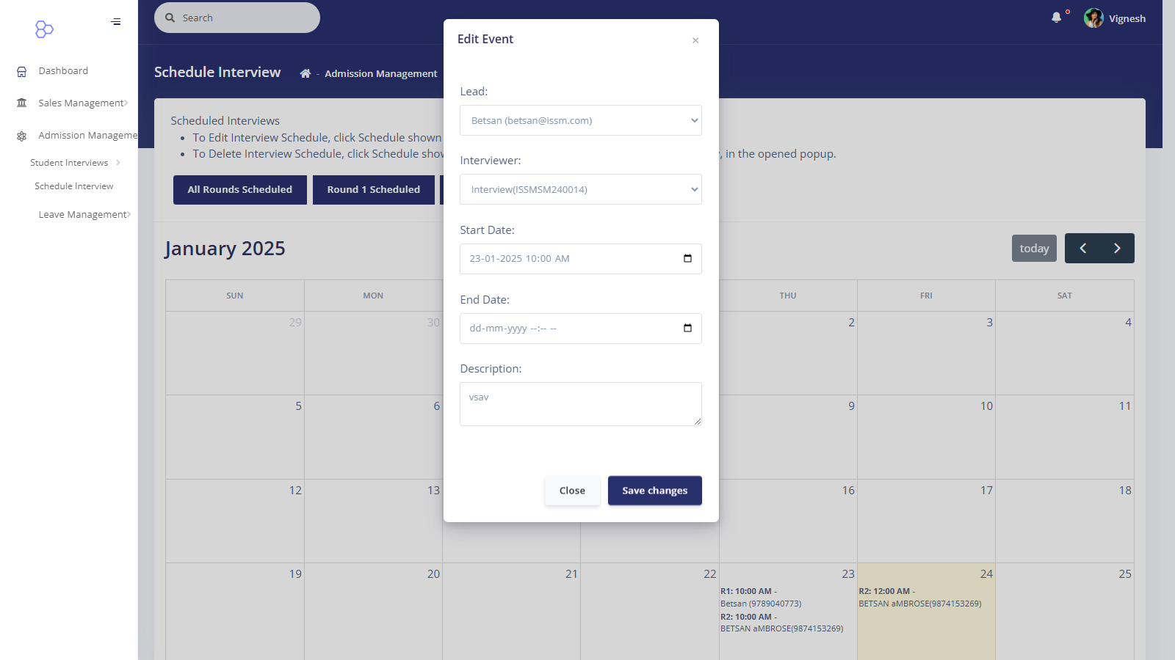

Slide 30
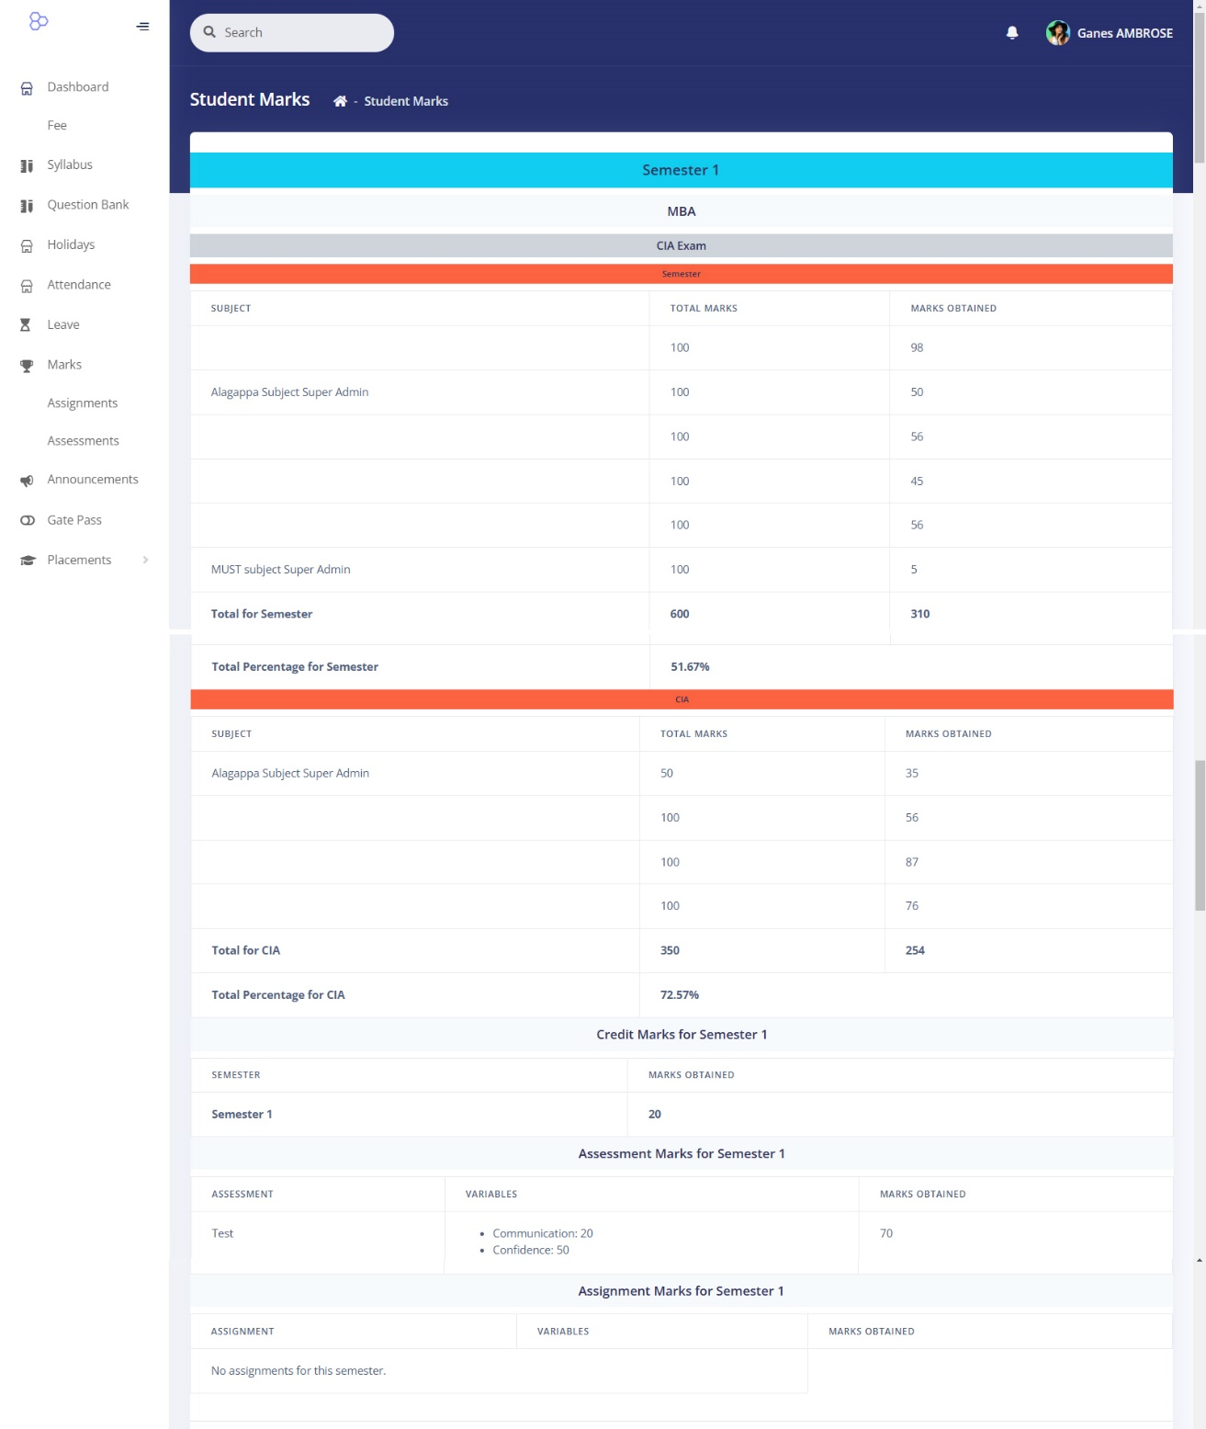

Slide 31
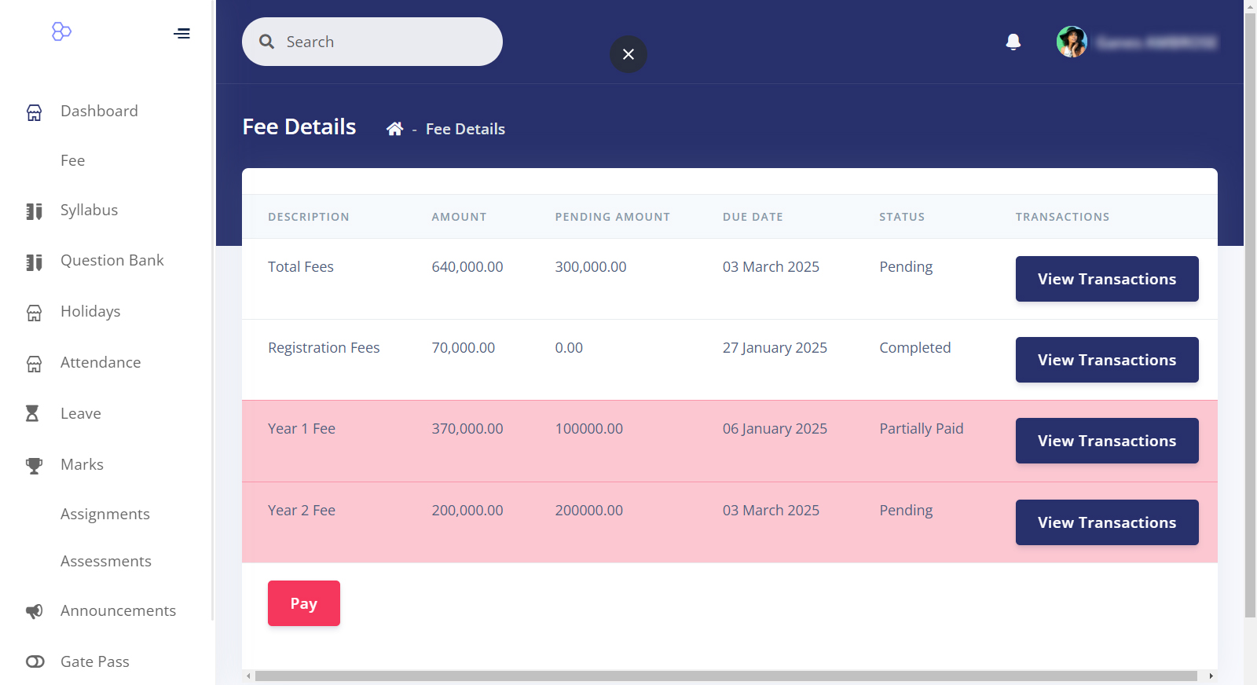

Slide 32
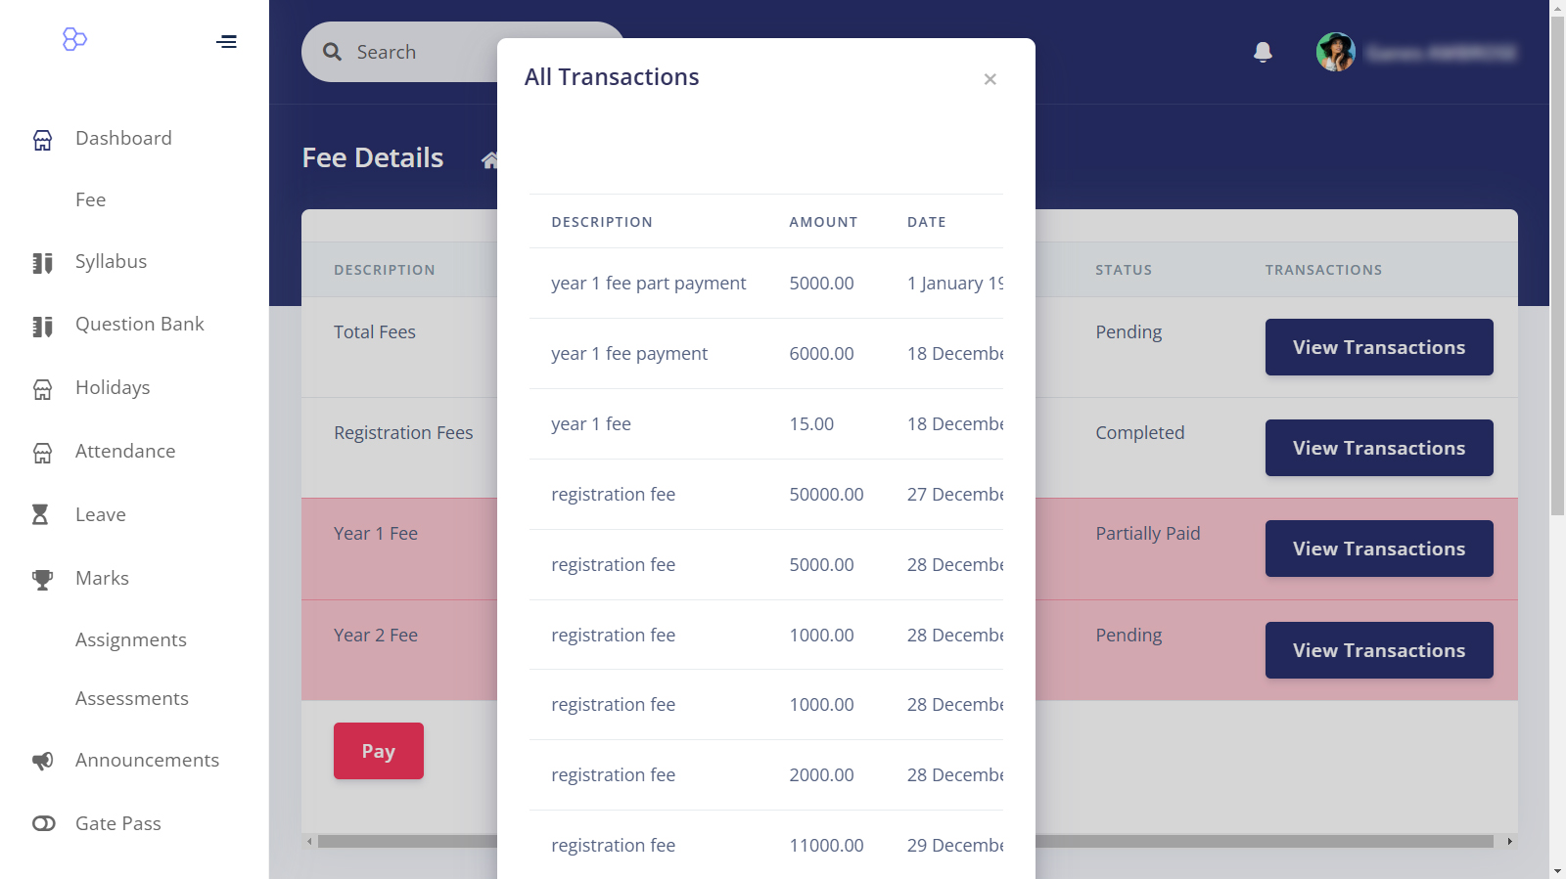

Slide 33
THANK YOU

